Slide 1
Kobe Bryant Shot Selection Which shots did Kobe sink?
Presented by
Divya Parmar
Pranay Bhakthula

Slide 2
Project overview
The focus of this project is to predict the probability of NBA player Kobe brayant’s successful shots.
An analysis of kobe’s play in years 2002,2009 from opponent POV to defend him in championship finals.
It will be demonstrated using following algorithms:
1. Random forest classifier
2. Multiplayer Perceptron(MLP) classifier

Slide 3
Dataset Description
This data contains the location and circumstances of every field goal attempted by Kobe Bryant took during his 20-year career.
This dataset contains 30697 entries of which 5000 observations of our target variable are missing, and there are 25 features of which most of them are categorical.
Source: https://www.kaggle.com/c/kobe-bryant-shot-selection/data
Target variable : shot_made_flag
This dataset contains only Field Goals(2,3 pointers), it does not contain kobe’s points from rebounds, assists, free throws.

Slide 4
Data Preprocessing
Dropped 5000 observations since target variable shot_made_flag has 5000 inherent missing values.
dropped game_event_id, game_id, lat, loc_x, loc_y, lon, minutes_remaining, seconds_remaining, minutes_remaining, team_name, team_id, game_date, game_date, matchup, opponent, shot_id columns since they have no influence on target variable.
Label encoder is applied to the features since all the features after dropping above columns are categorical.
MinMaxscaler is used to scale the values between 0 and 1.
Change shot distance max to 40 to reduce variable range caused by outliers.

Slide 5
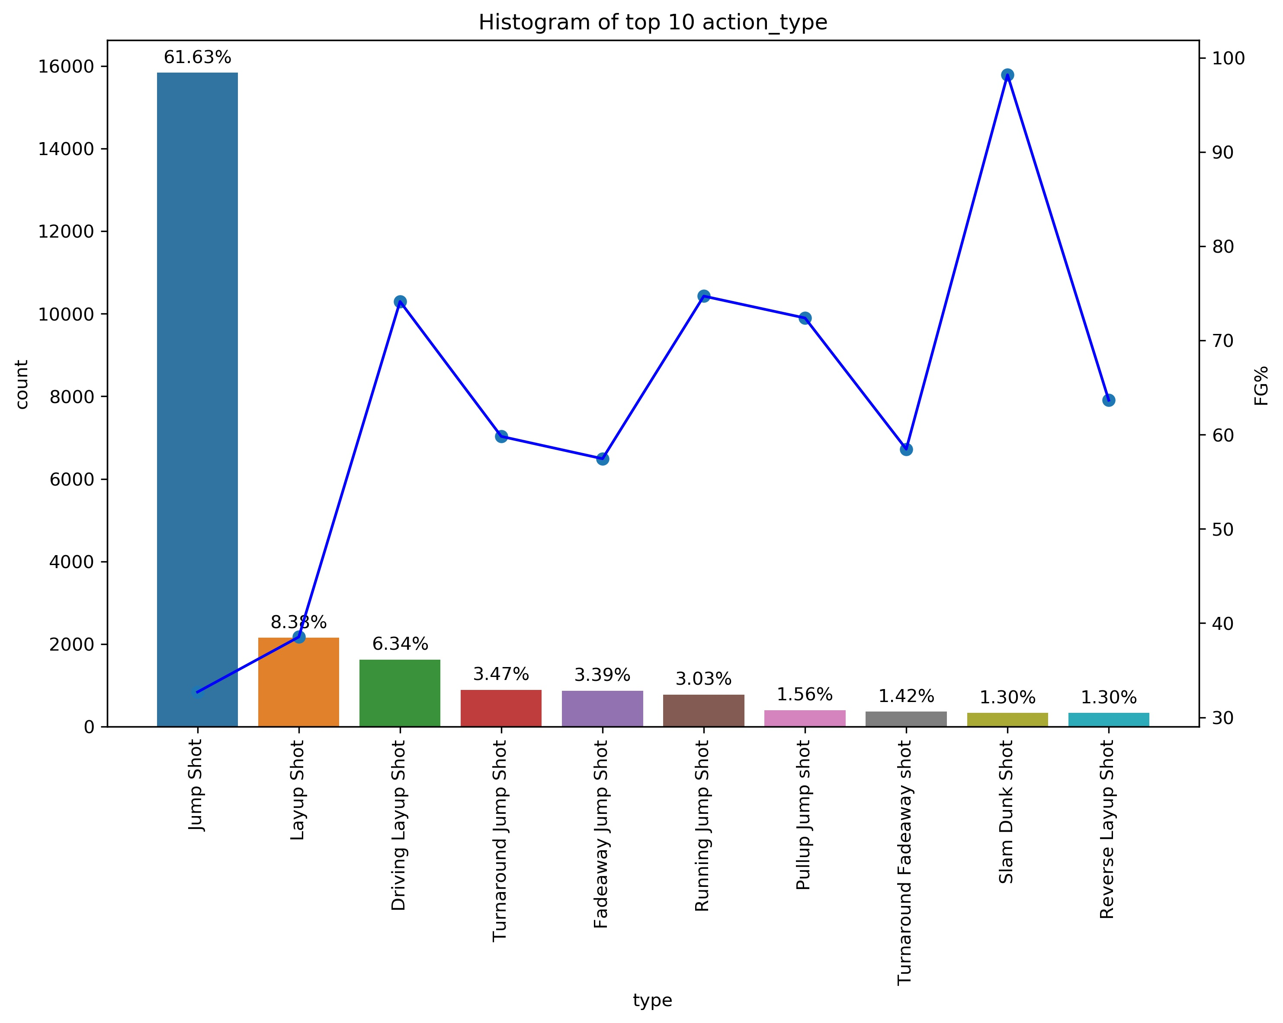
EDA Analysis
The graphs we are going to see are histograms on one axis arranged in descending order and Field goal% on 2nd axis.
The percentage on top of each bar represents percentage of usage of that particular type in that column
The line plot represents,
field goal(FG) % = (no. of successful shots in particular type)/
(total no. of attempted shots in that particular type)
This histogram on the right shows top 10 action types that kobe used most during his career.
We can observe that he uses jump shot the most followed by layup shot.
We can also observe that FG% is least for jumpshot and highest for slam dunk shot.

Slide 6
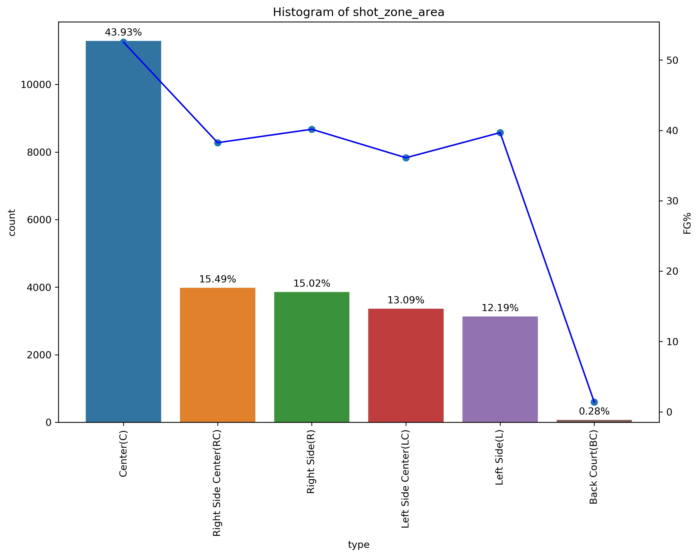
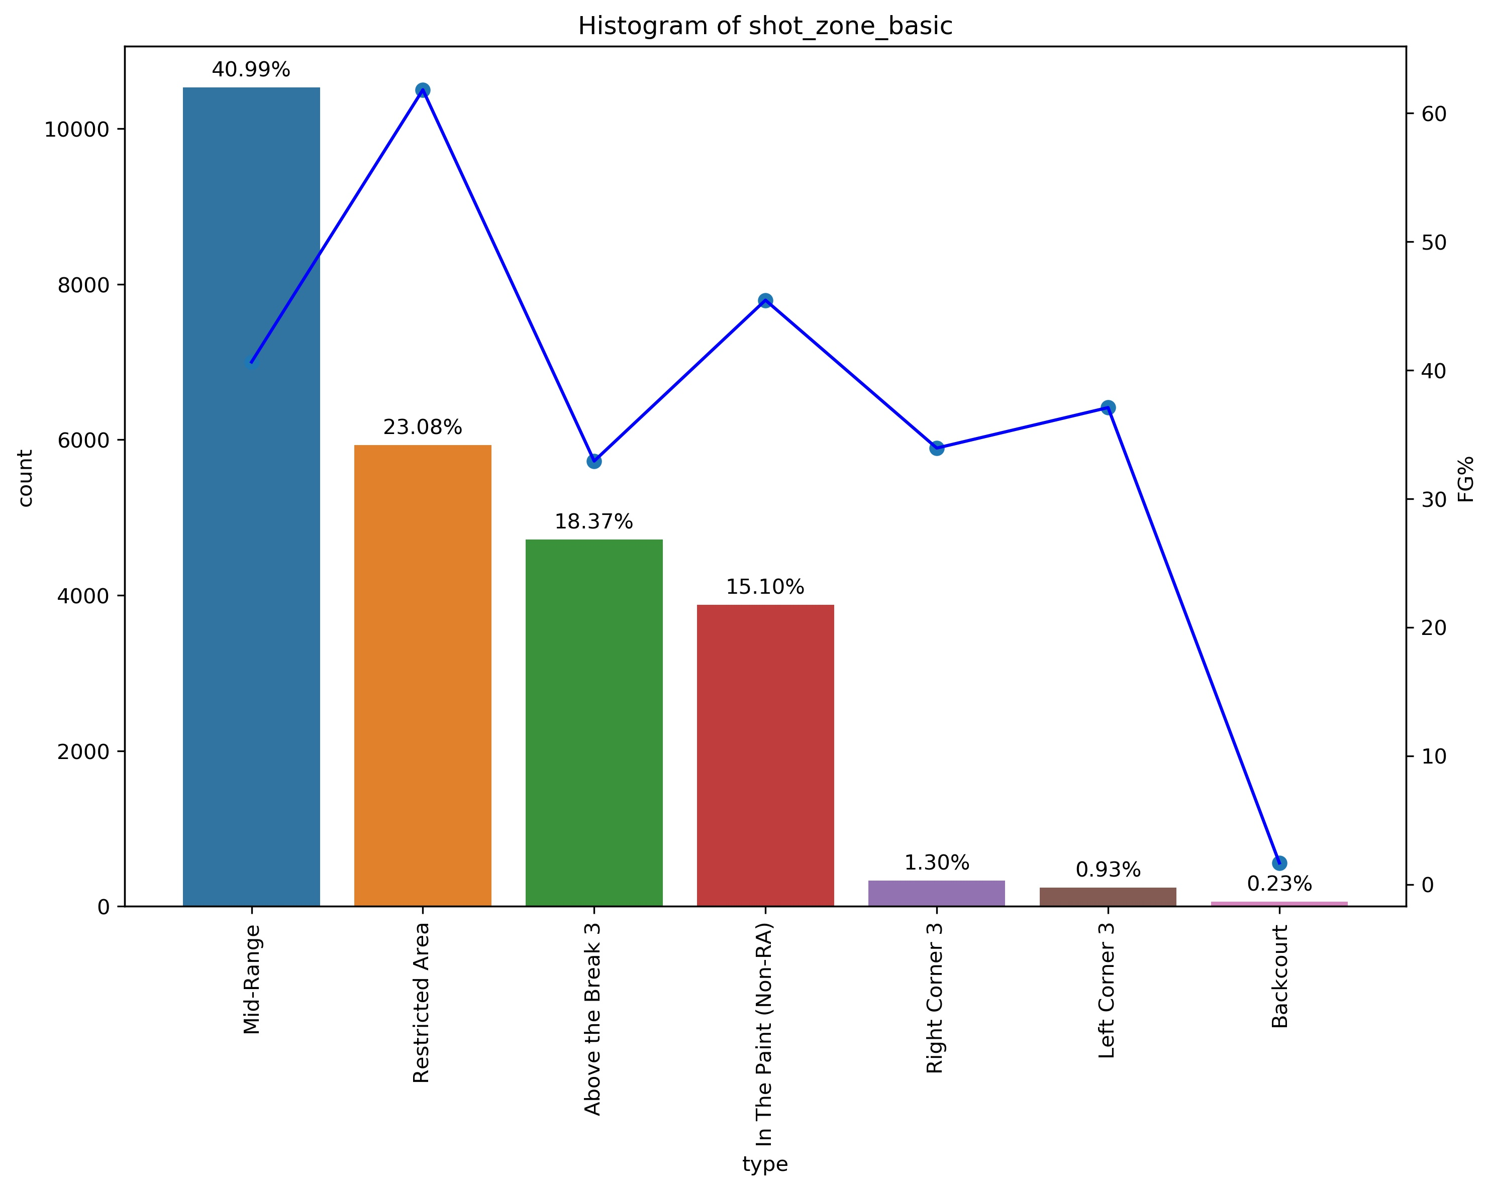
EDA analysis
The plot on the right is histogram of shot_zone_area. We can observe that kobe shoots most of his shots (43.93%) from center area followed by right side center.
The FG% is also highest for center area, so it is also his most effective area of shooting.
The plot on the left is histogram of shot_zone _basic. We can observe that kobe shoots most of his shots from Mid-Range(40.99%) followed by Restricted Area.
We can also observe that FG% is highest for Restricted Area so that is his most effective zone of shooting. We can see that his least favourite area to shoot is Backcourt.

Slide 7
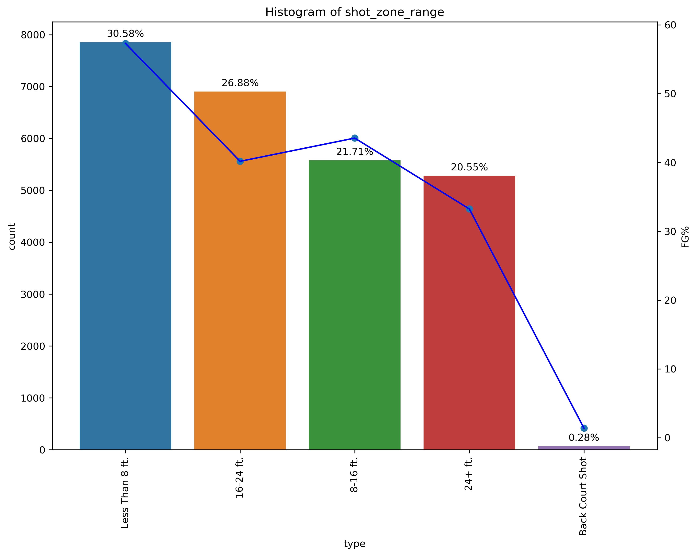
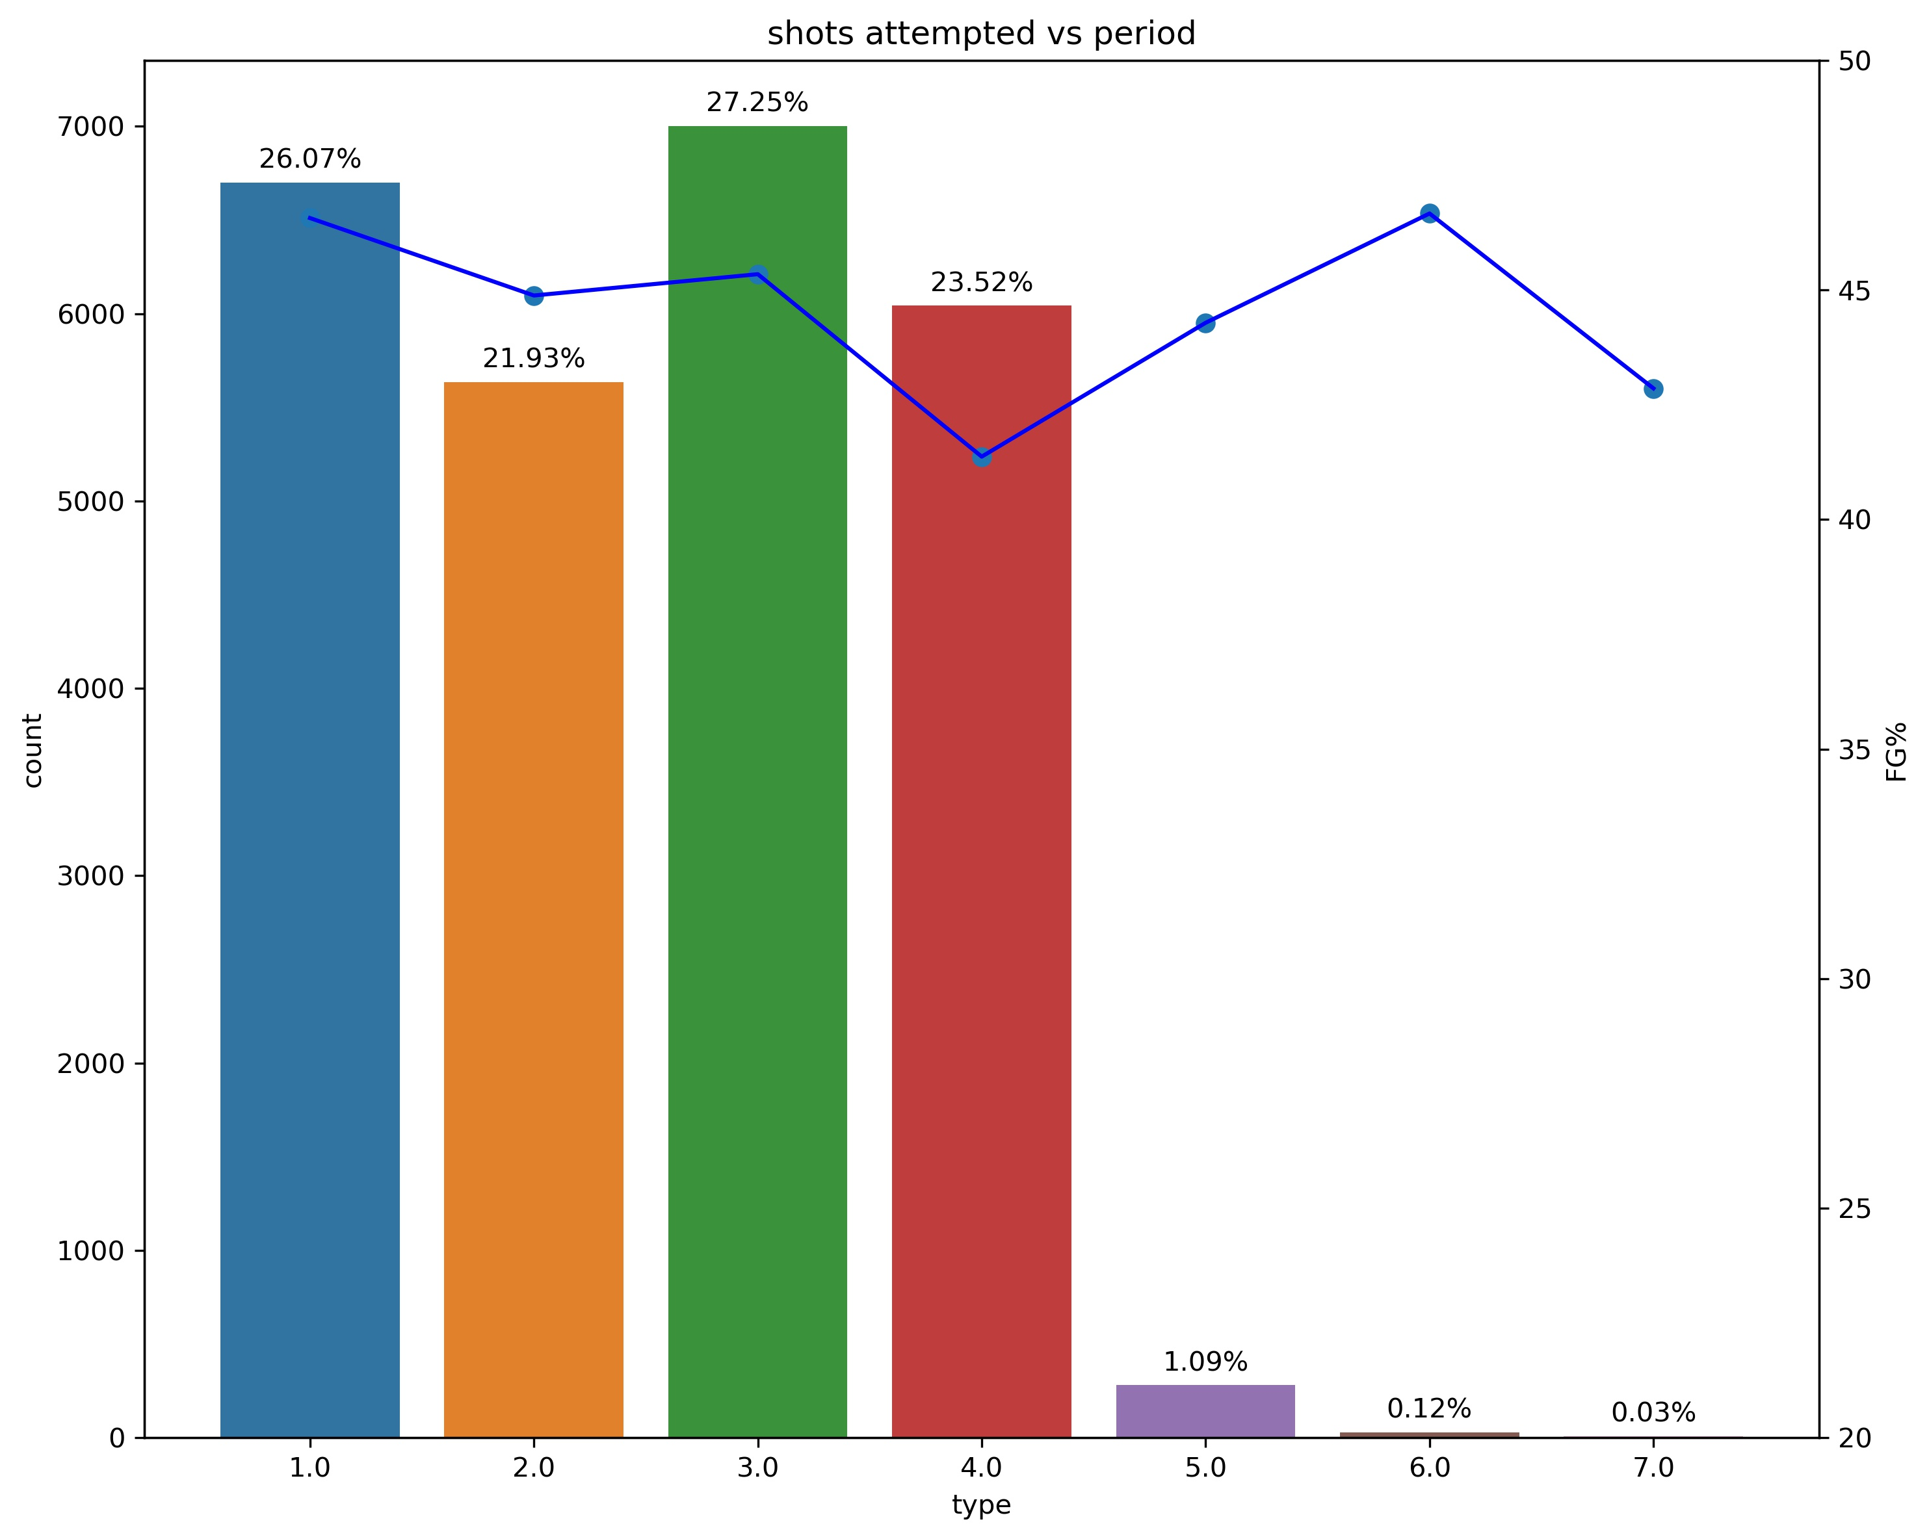
EDA analysis
The plot on the right is histogram of shot_zone_range. We can observe that kobe shoots most of his shots (30.58 %) from Less that 8ft range followed by 16-24ft range.
The FG% is also highest for Less that 8ft range, so it is also his most effective range of shooting.
The plot on the left is histogram of period. We can observe that kobe is generally more active in 1st and 3rd quarters and most inactive for 2nd quarter. This is technique he follows so he conserve his energy in 2nd quarter and make most out of 3rd quarter and perform clutch moments in 4th quarter
We can also observe that FG% is highest for 1st quarter so that is his most effective period.

Slide 8
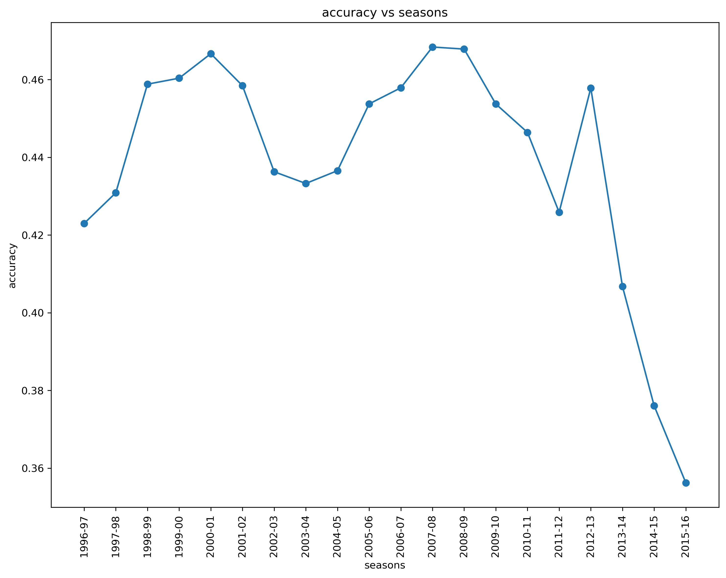
EDA analysis
The plot on the right shows accuracy of shots attempted by kobe for various seasons.
We can observe that kobe performed with highest accuracy in the seasons 1999-00, 2000-01 and 2001-02 where he won championships those years to perform three-peat.
He again peaked in seasons 2007-08, 2008-09 and 2009-10 where he won championships in years 2009 and 2010.
We can observe that his accuracy faded above in his final years reaching his lowest in 2015-16 seasons.
So we can say that when ever kobe performs highest his team reaches playoffs and mostly win champion ships.

Slide 9
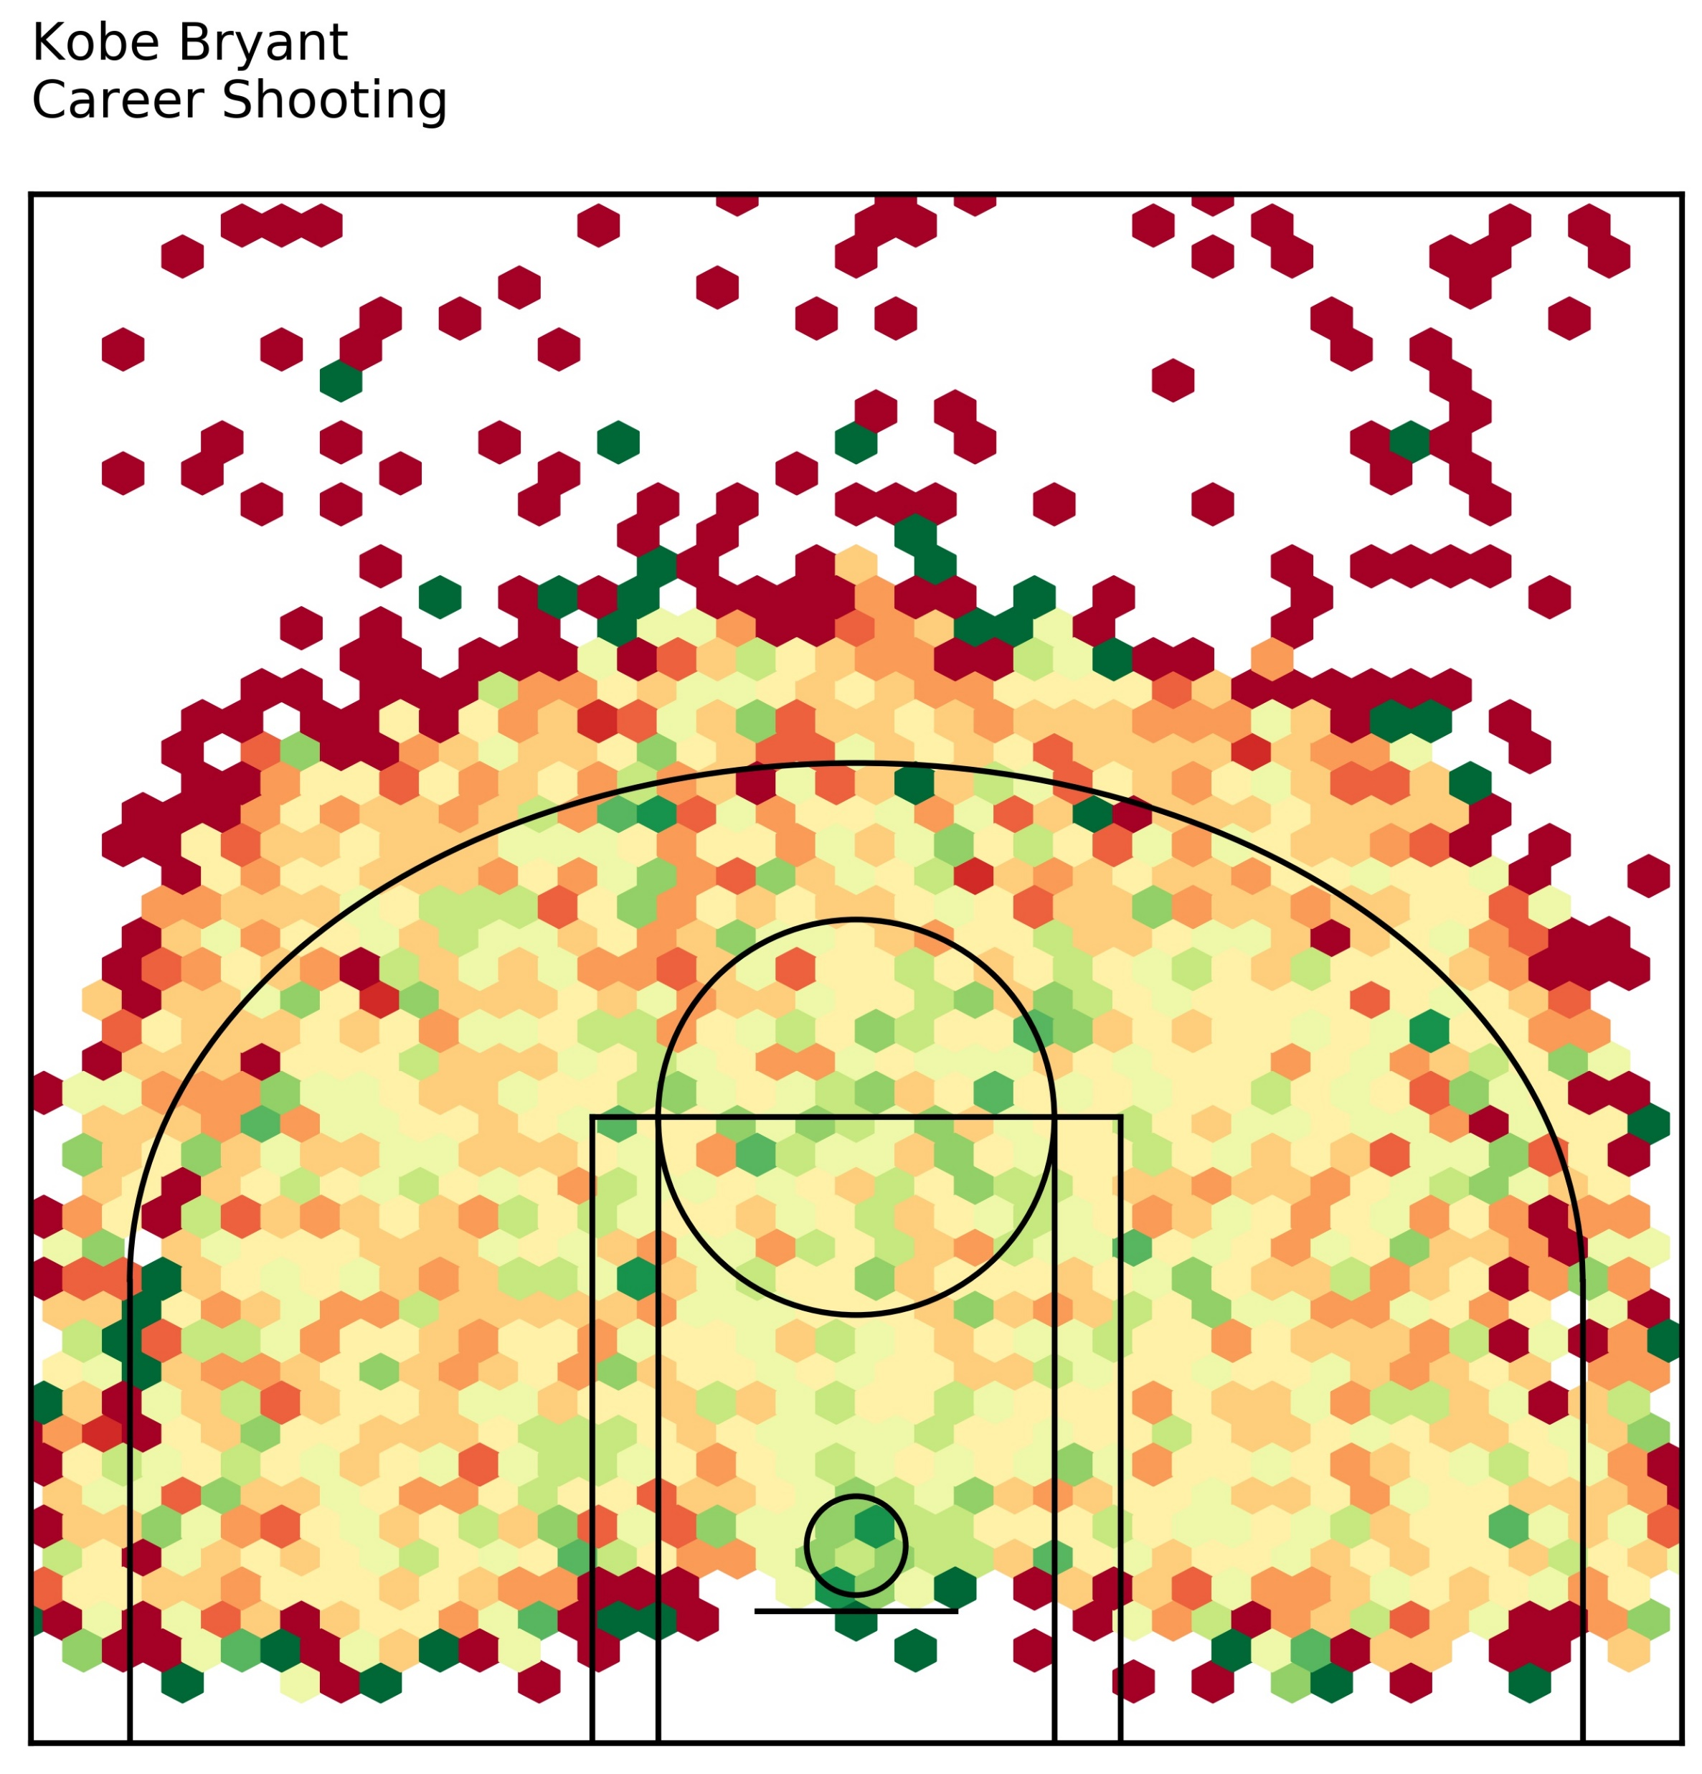
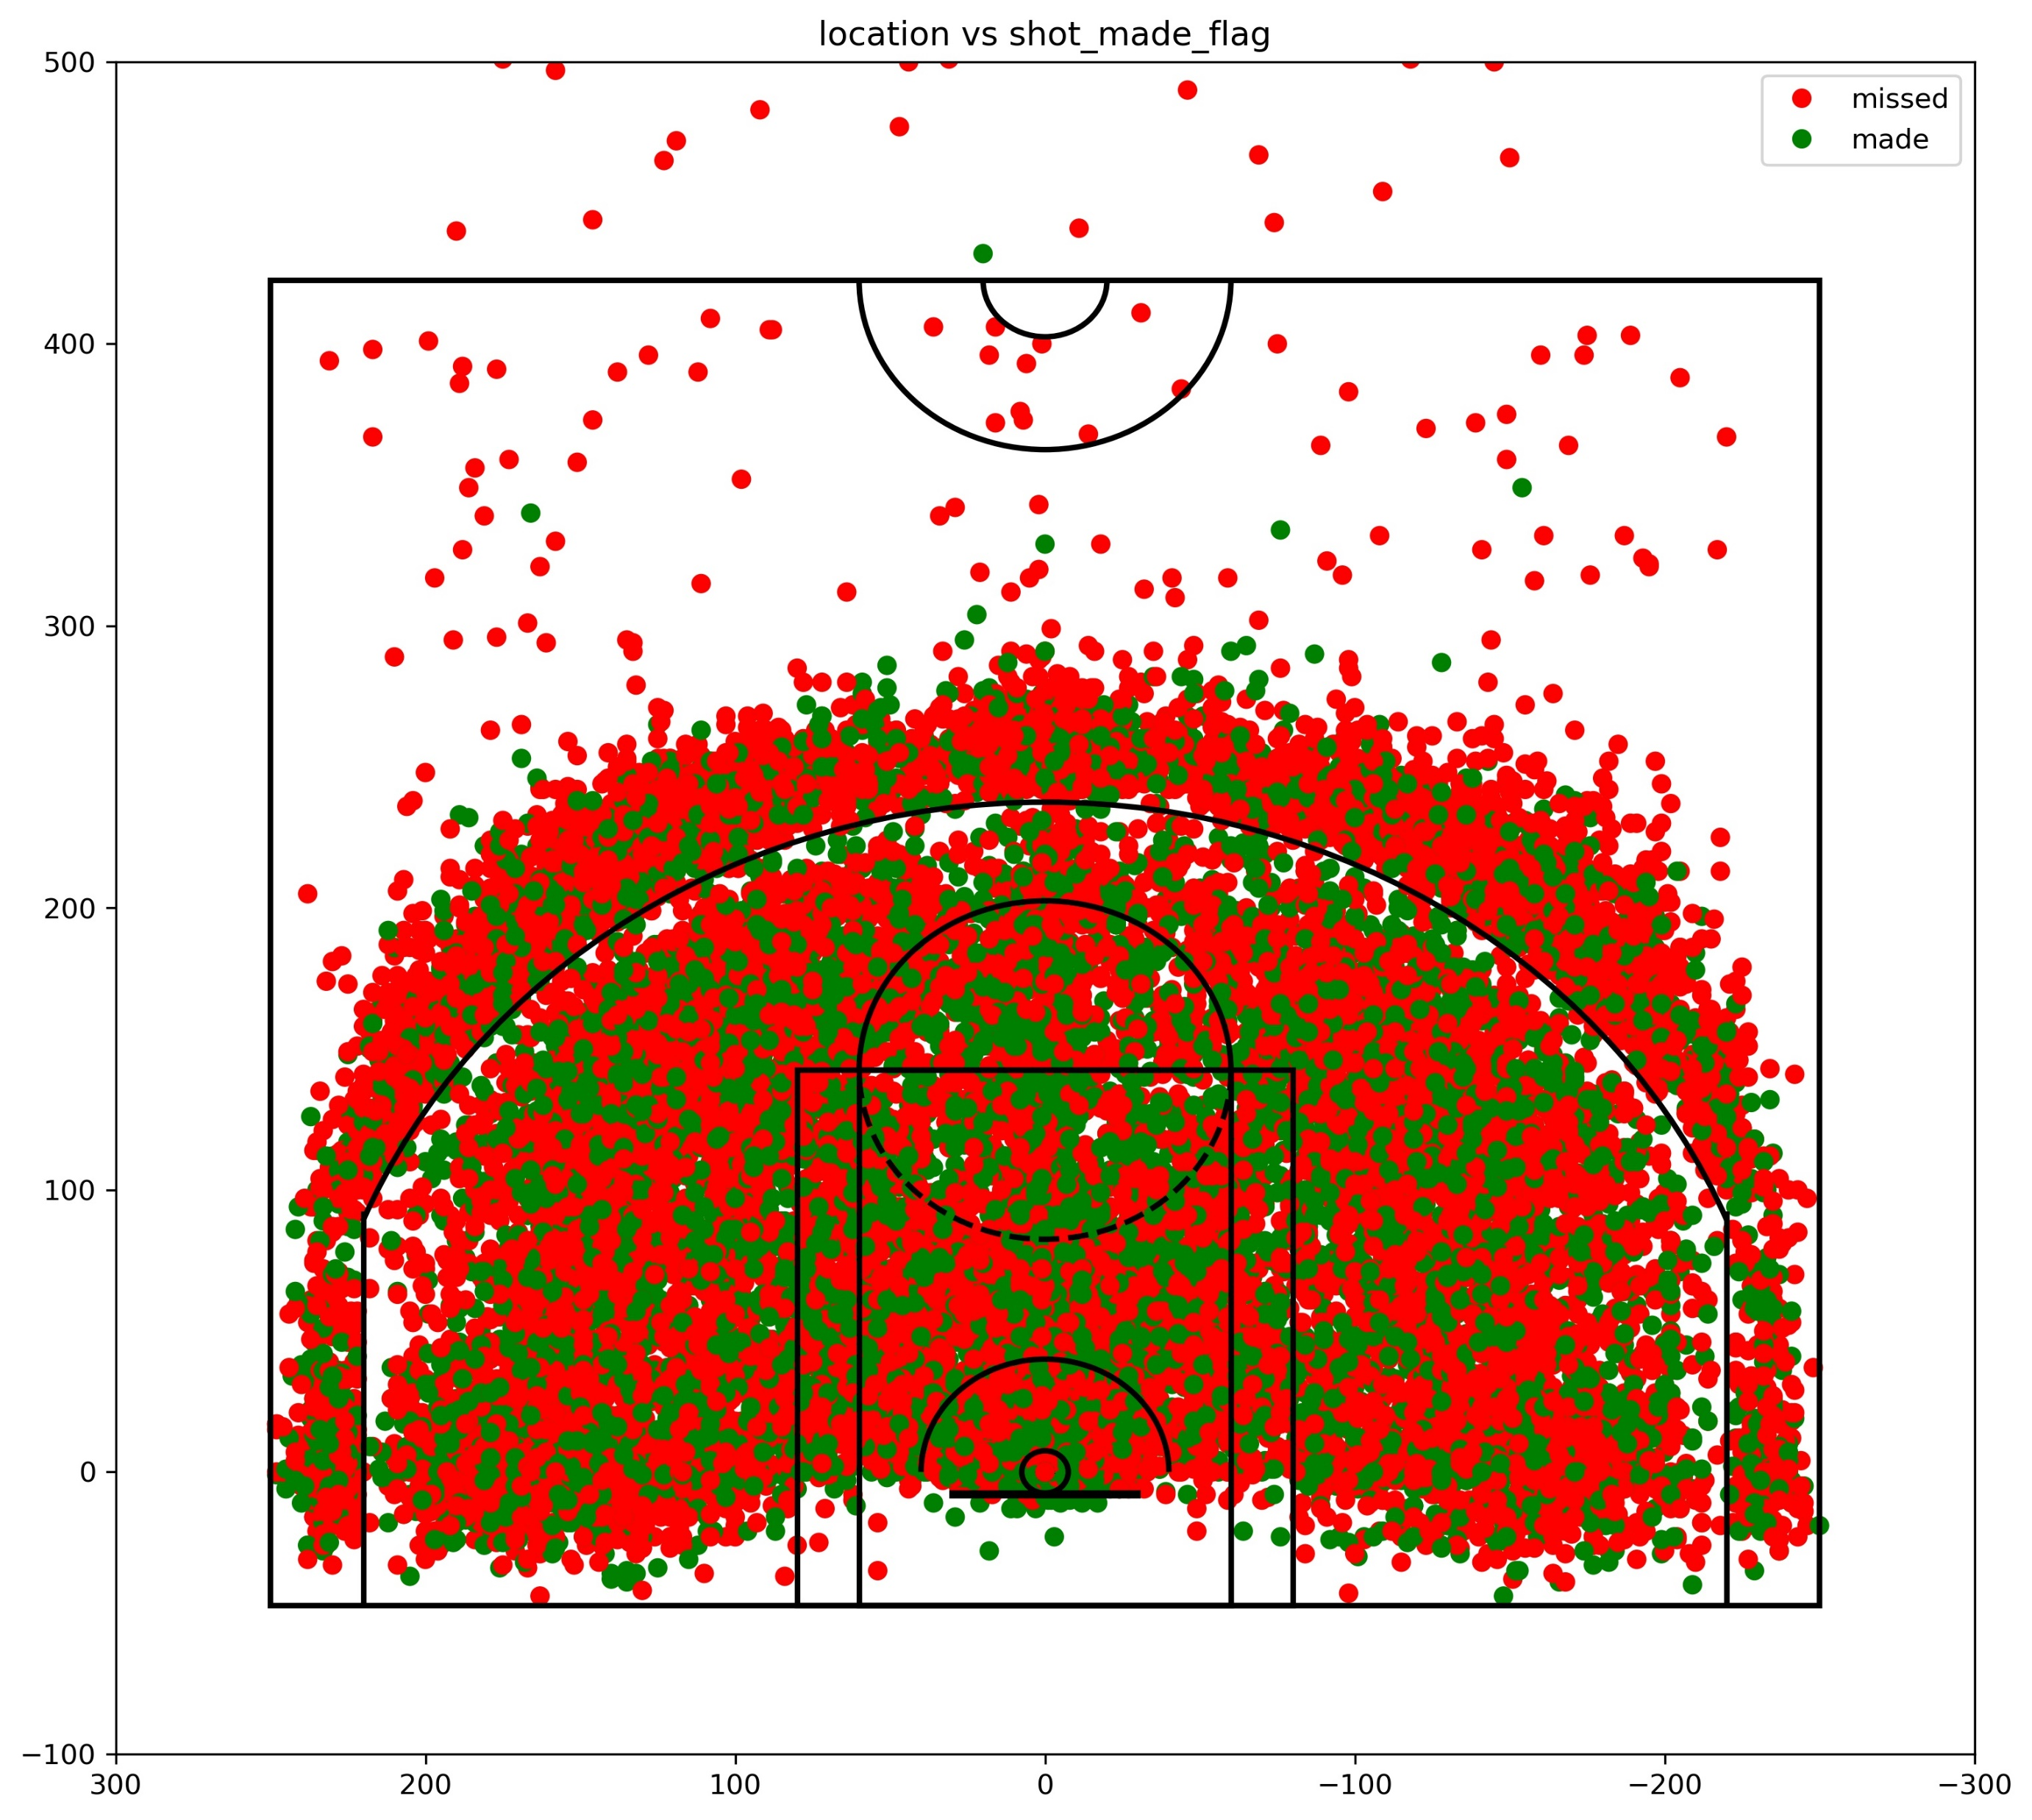
EDA analysis

Slide 10
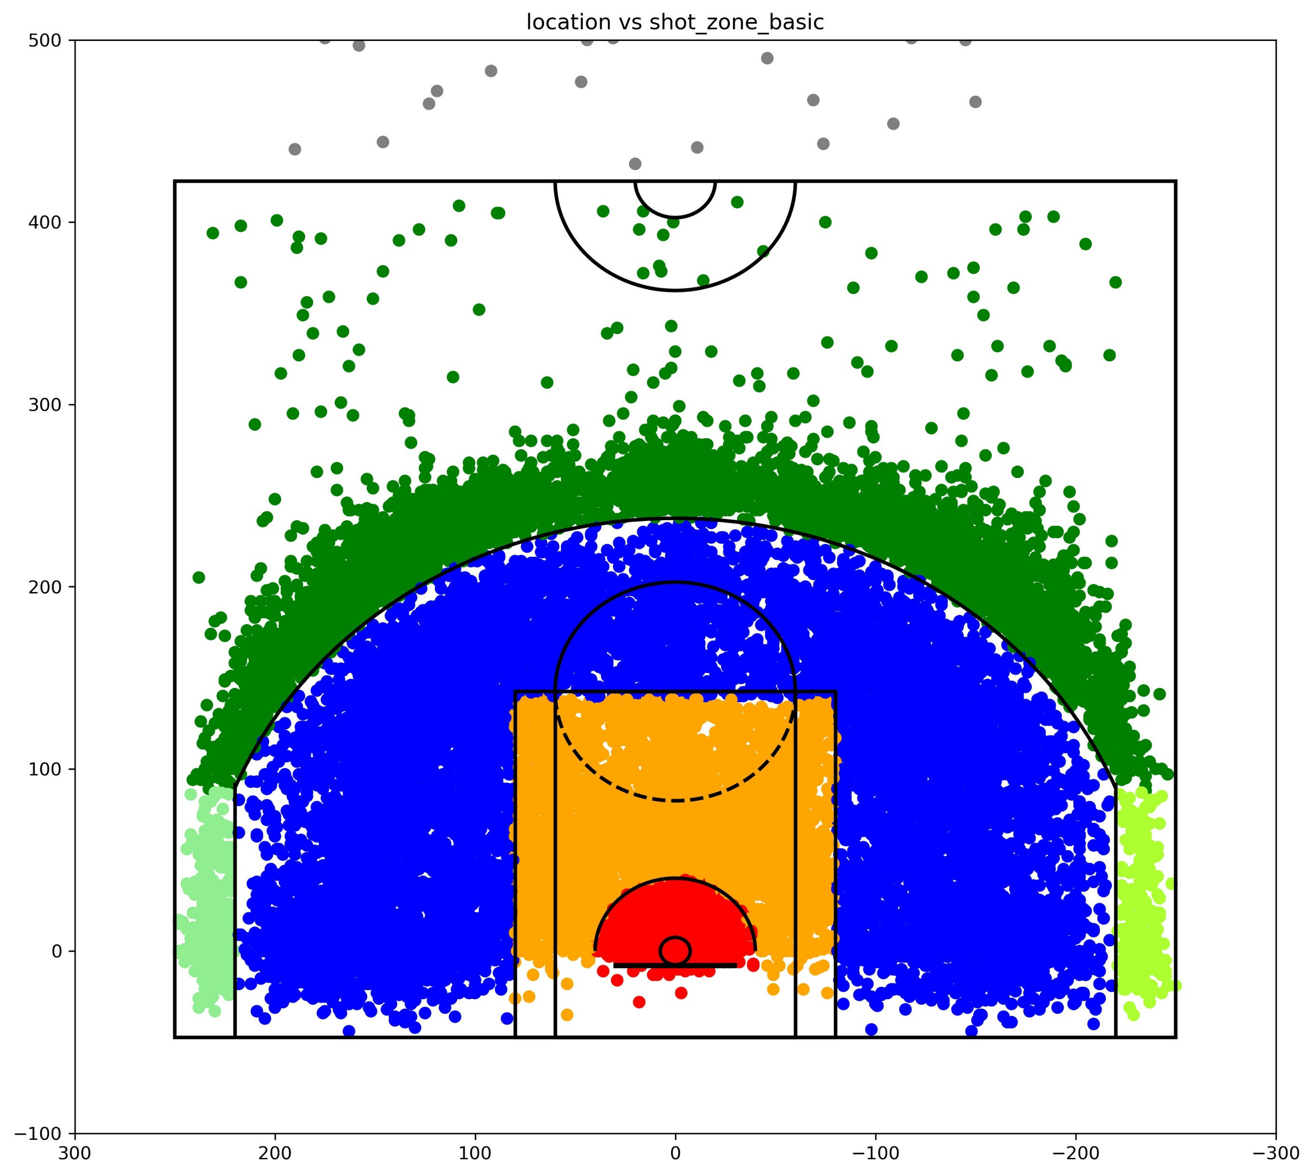
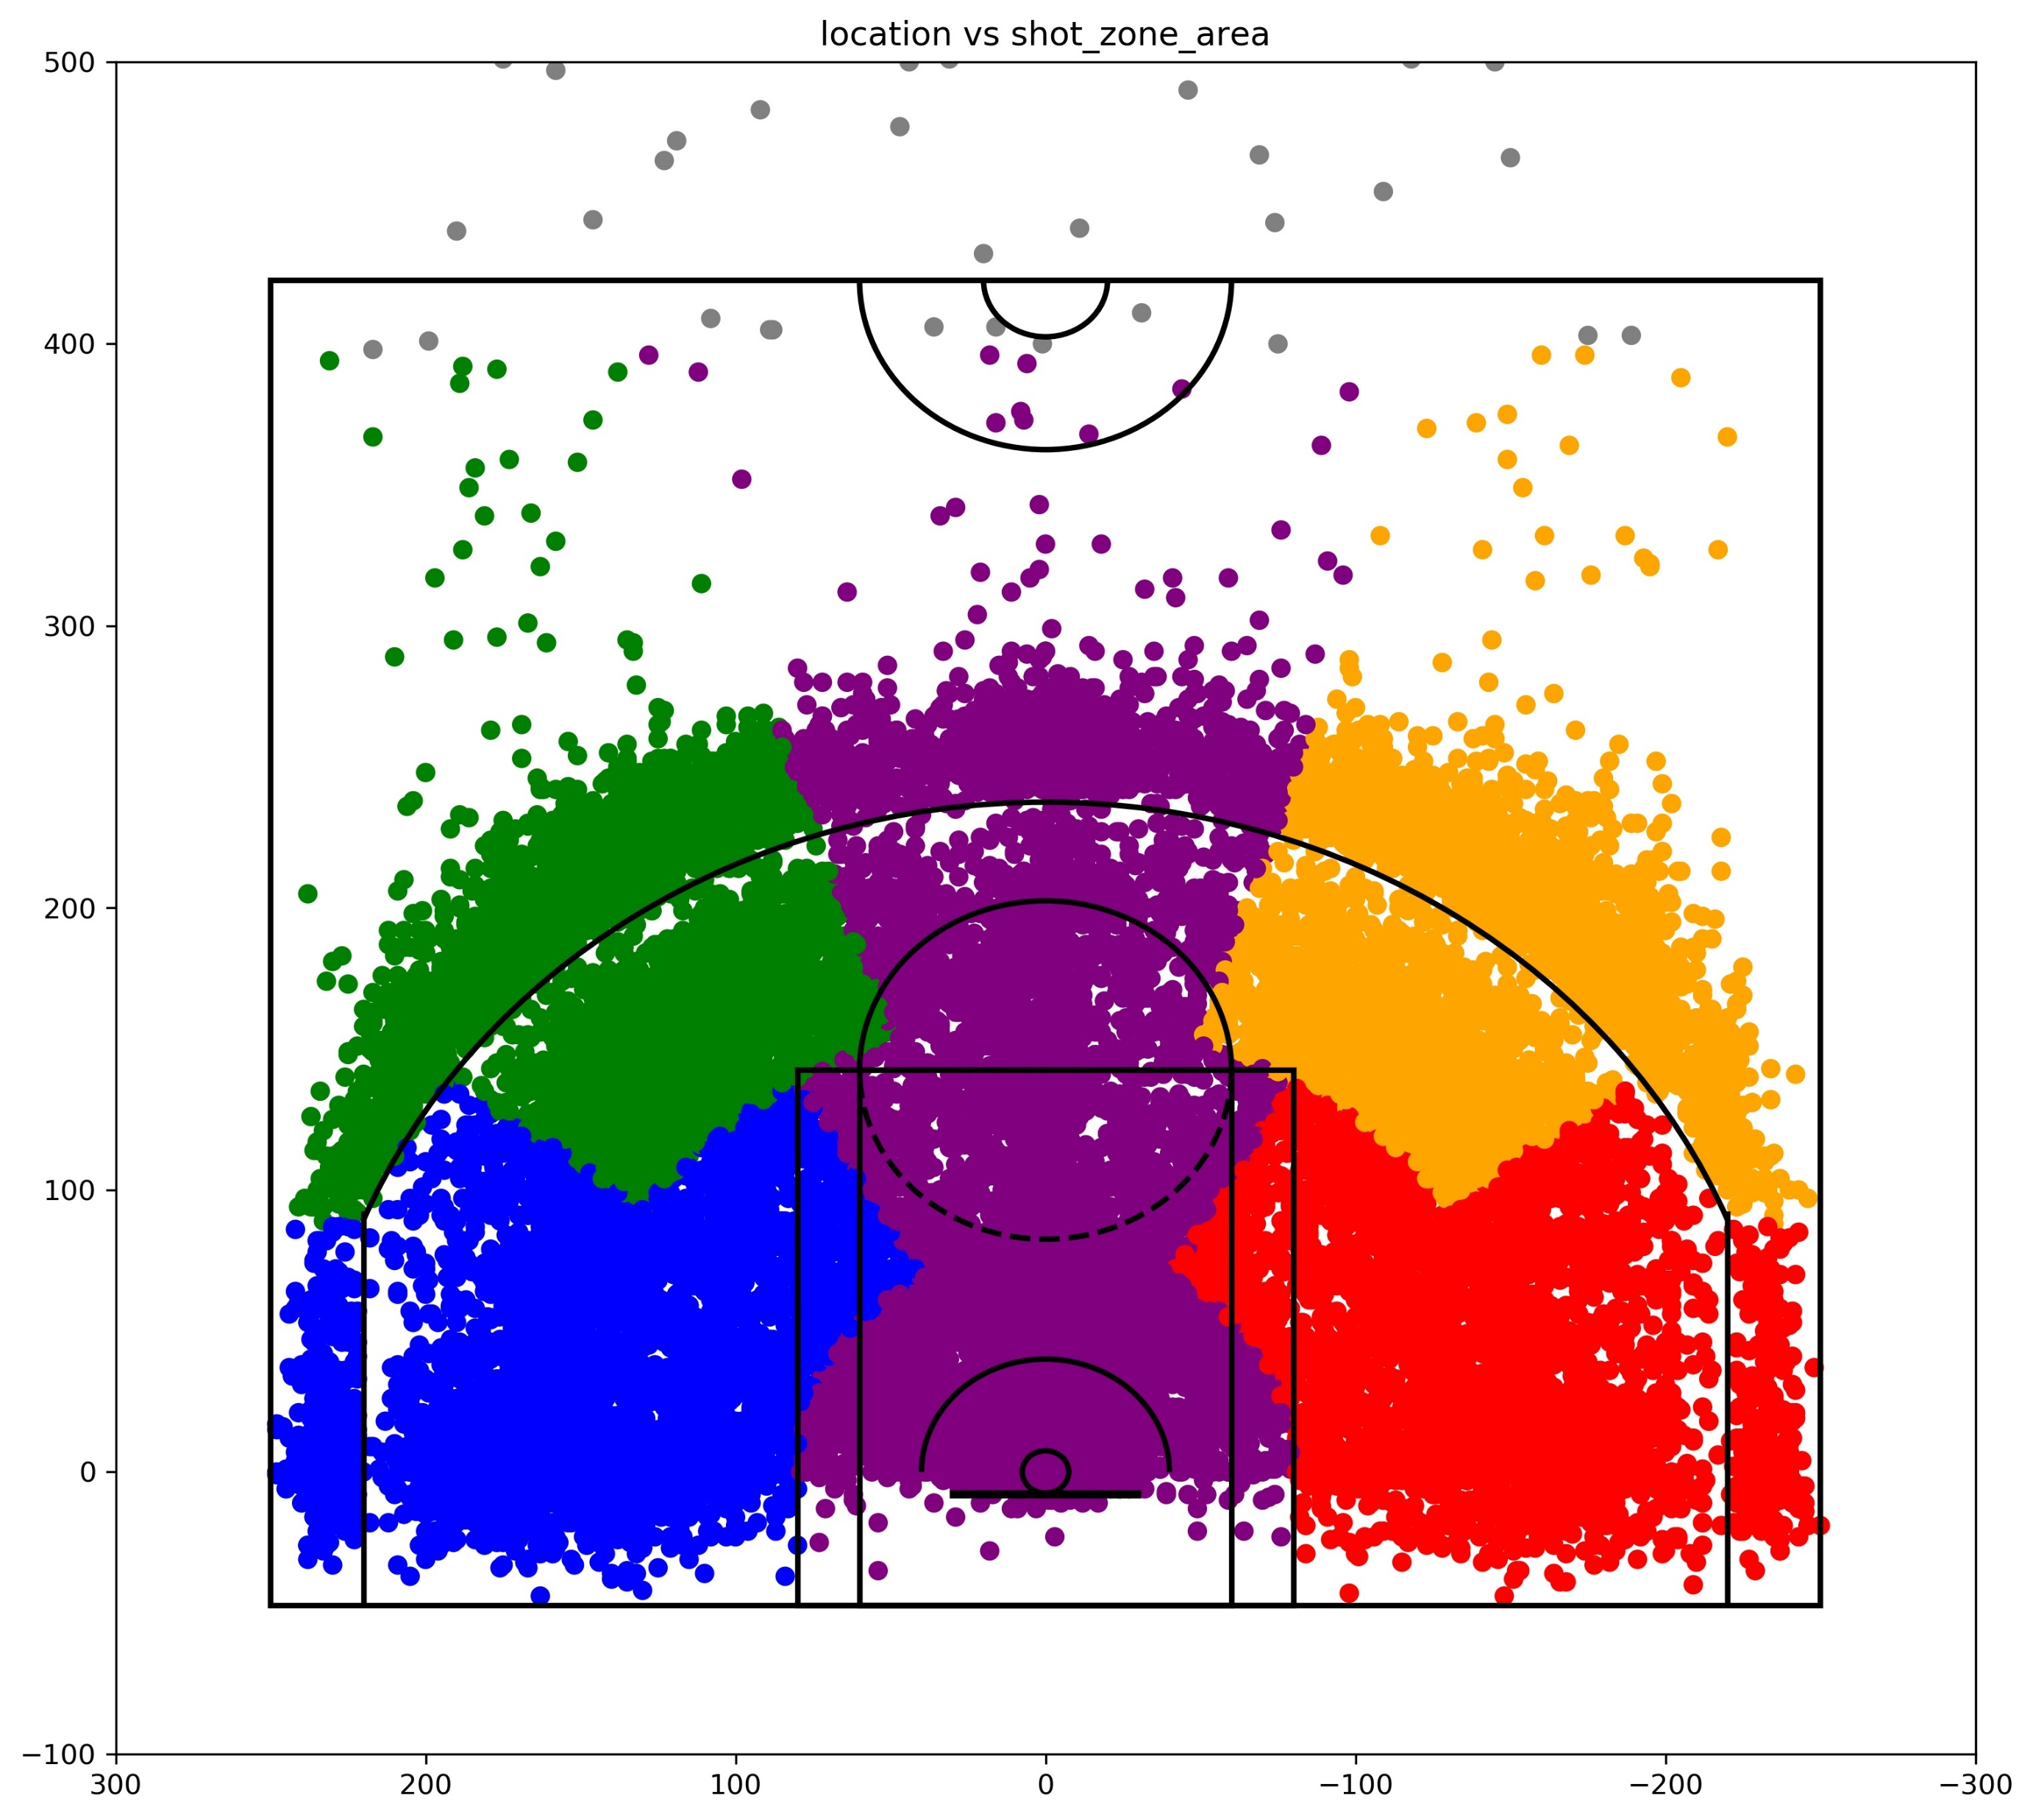
EDA analysis

Slide 11
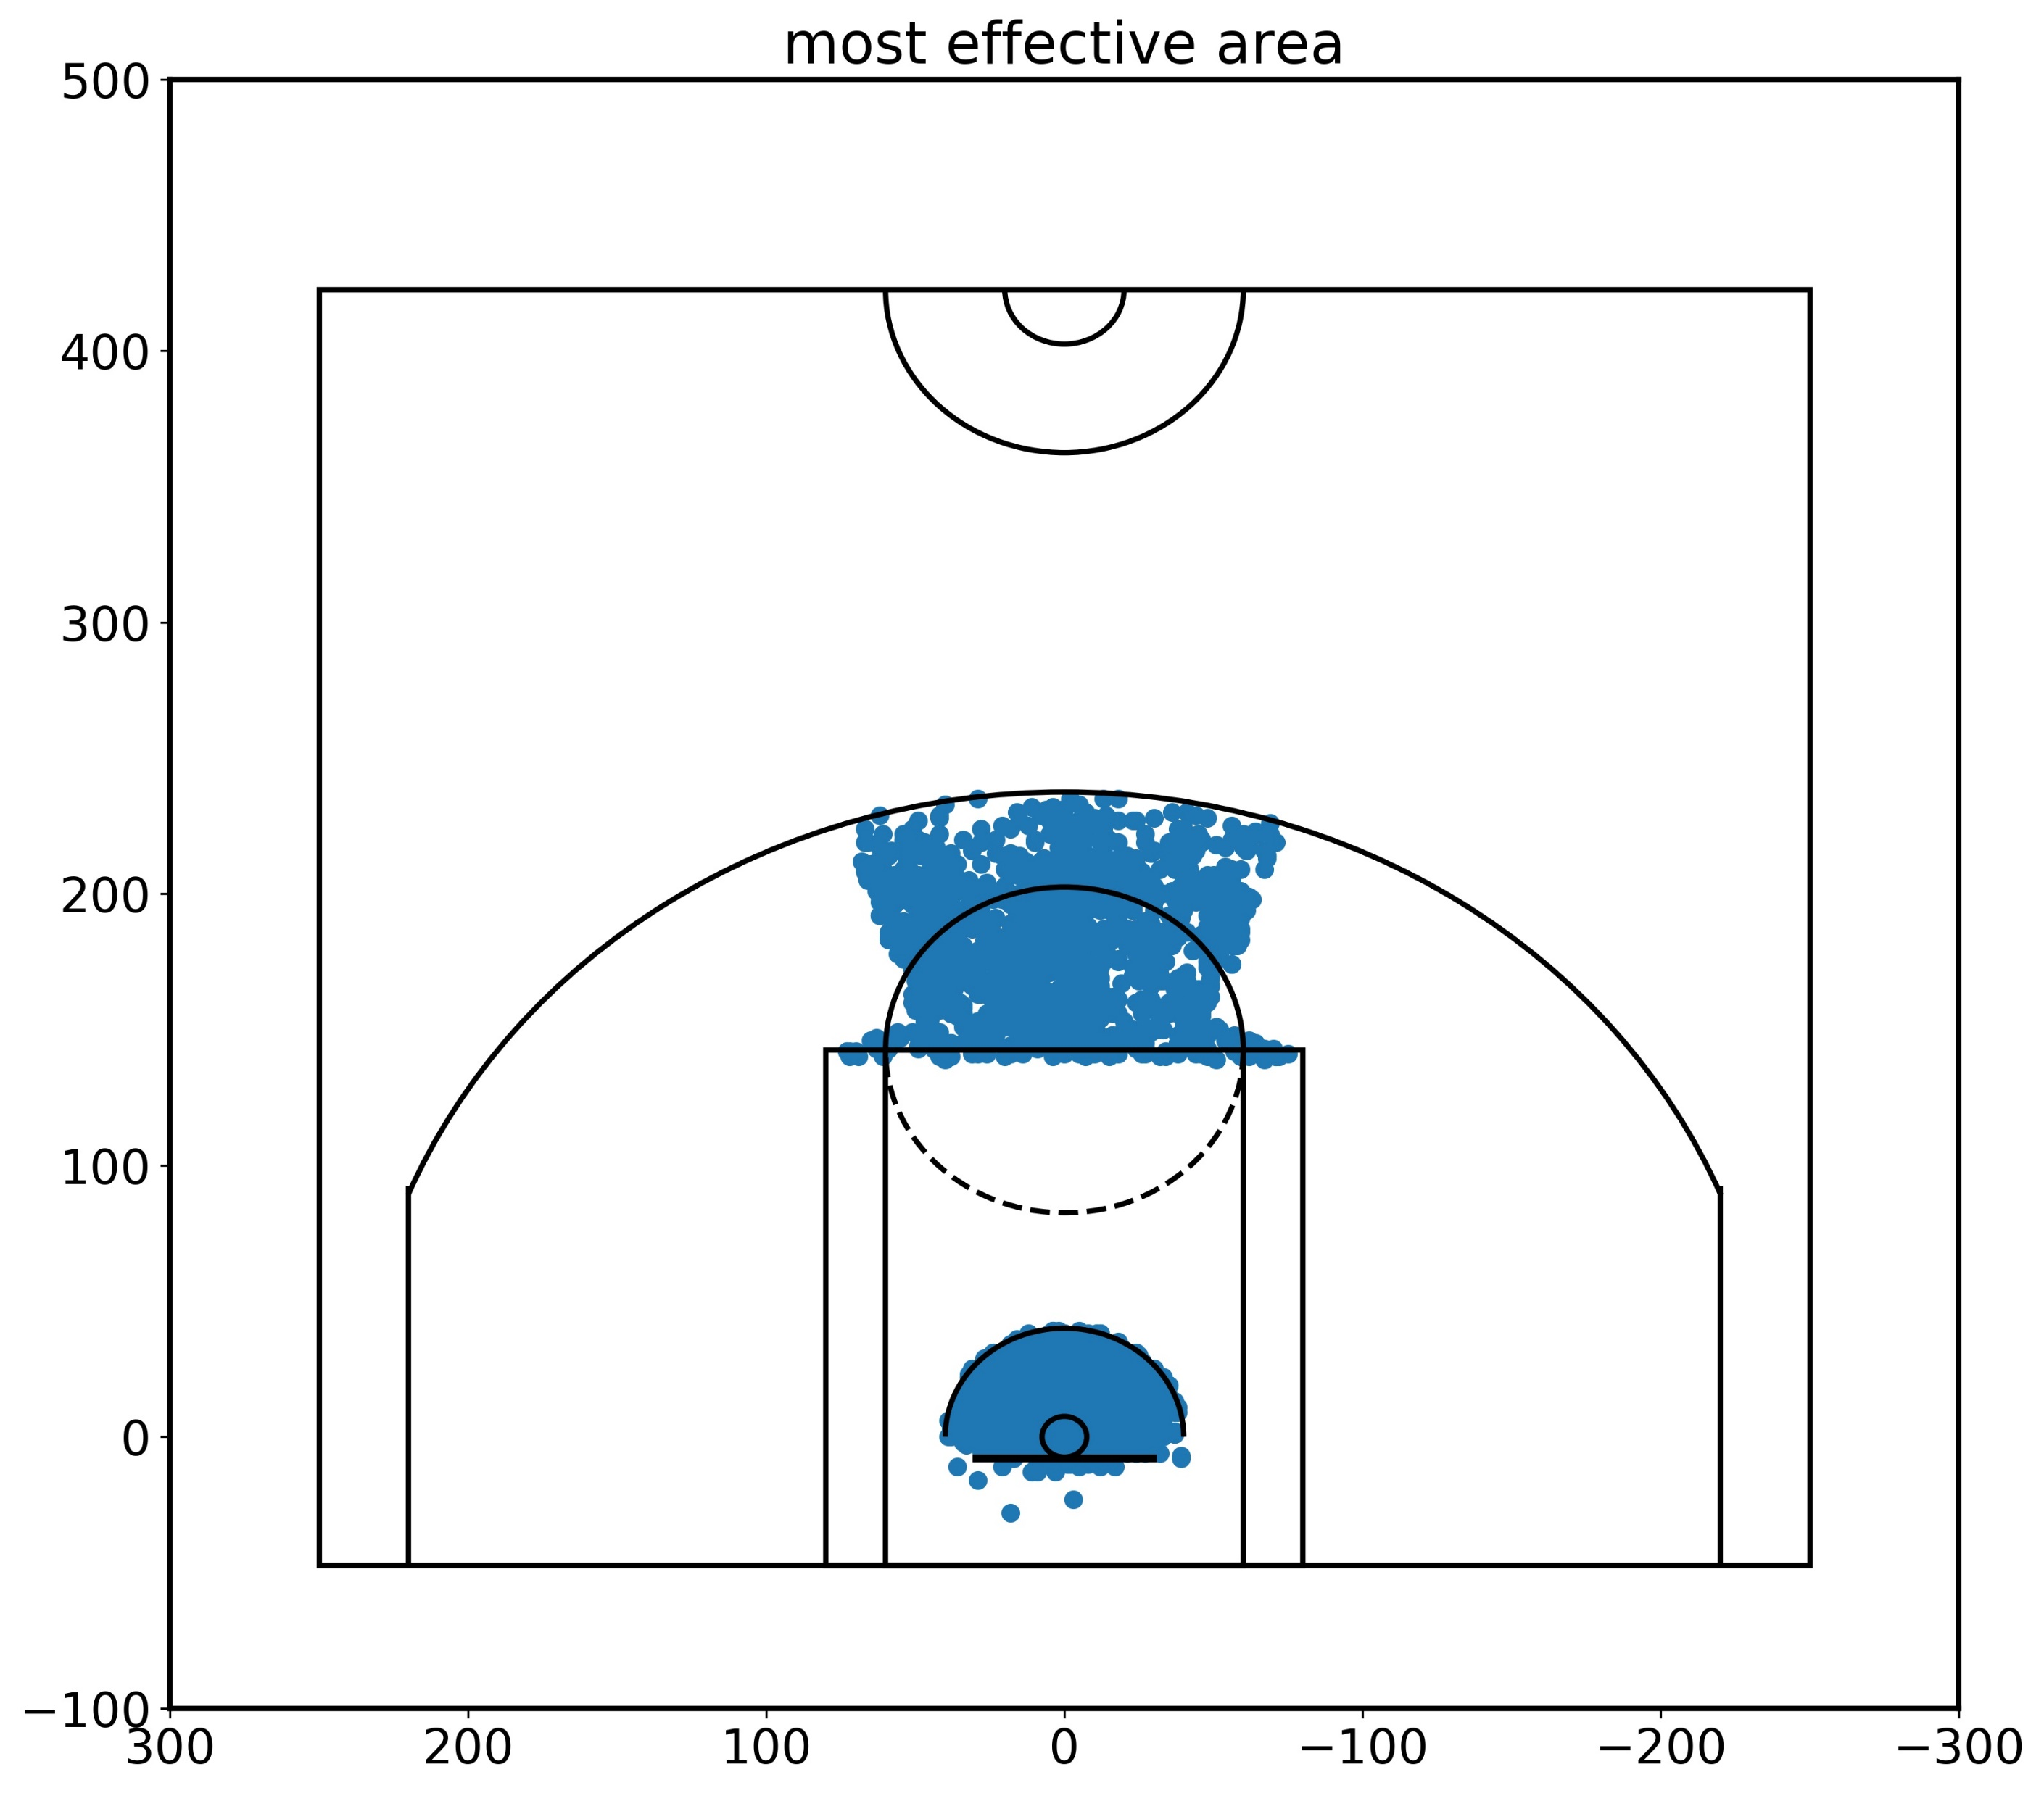
EDA analysis
The chart on the right shows the most effective areas of kobe’s play.
From the previous charts of location of shots and histogram graphs of various areas, ranges we can come to the conclusion that the most effective area for kobe is shooting from center area, from Mid-range and Restricted area. The most used action type is Jump shot.
For any opponent team playing against kobe, the best tactic is to make him stay away from this region as much as possible and also since he uses Jump shot the most it is better to assign him a taller opponent to counter his jump shot.

Slide 12
Opponent analysis
Now we will look from opponent point of view, who are championship finalist in the years 2002 and 2009 against Kobe’s team(LA lakers) and analyze kobe’s strengths and weakness from the data of regular season in those years and try to come up with a plan to defend Kobe better.
We chose 2002 and 2009 years because we wanted to analyze the Kobe’s play in the years when his teammate, another NBA star Shaquille O’Neal was in his team (2002) and not in his team (2009).
Shaq was more dominant than kobe in year 2002 as kobe was still young and less experienced compared to shaq. In the year 2009 the Kobe was peaking his career and he was the most dominant player in his side. So we can compare his play both those years.
In this analysis we will look at data against top team that kobe played the best and team that kobe performed the least.

Slide 13
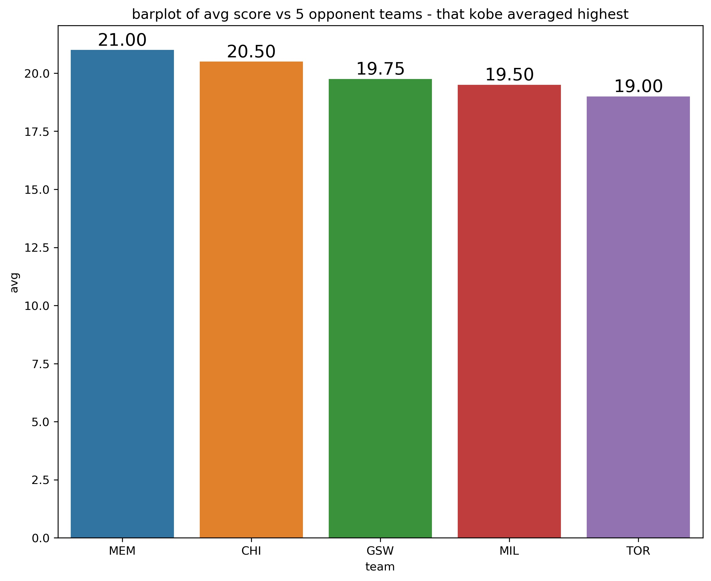
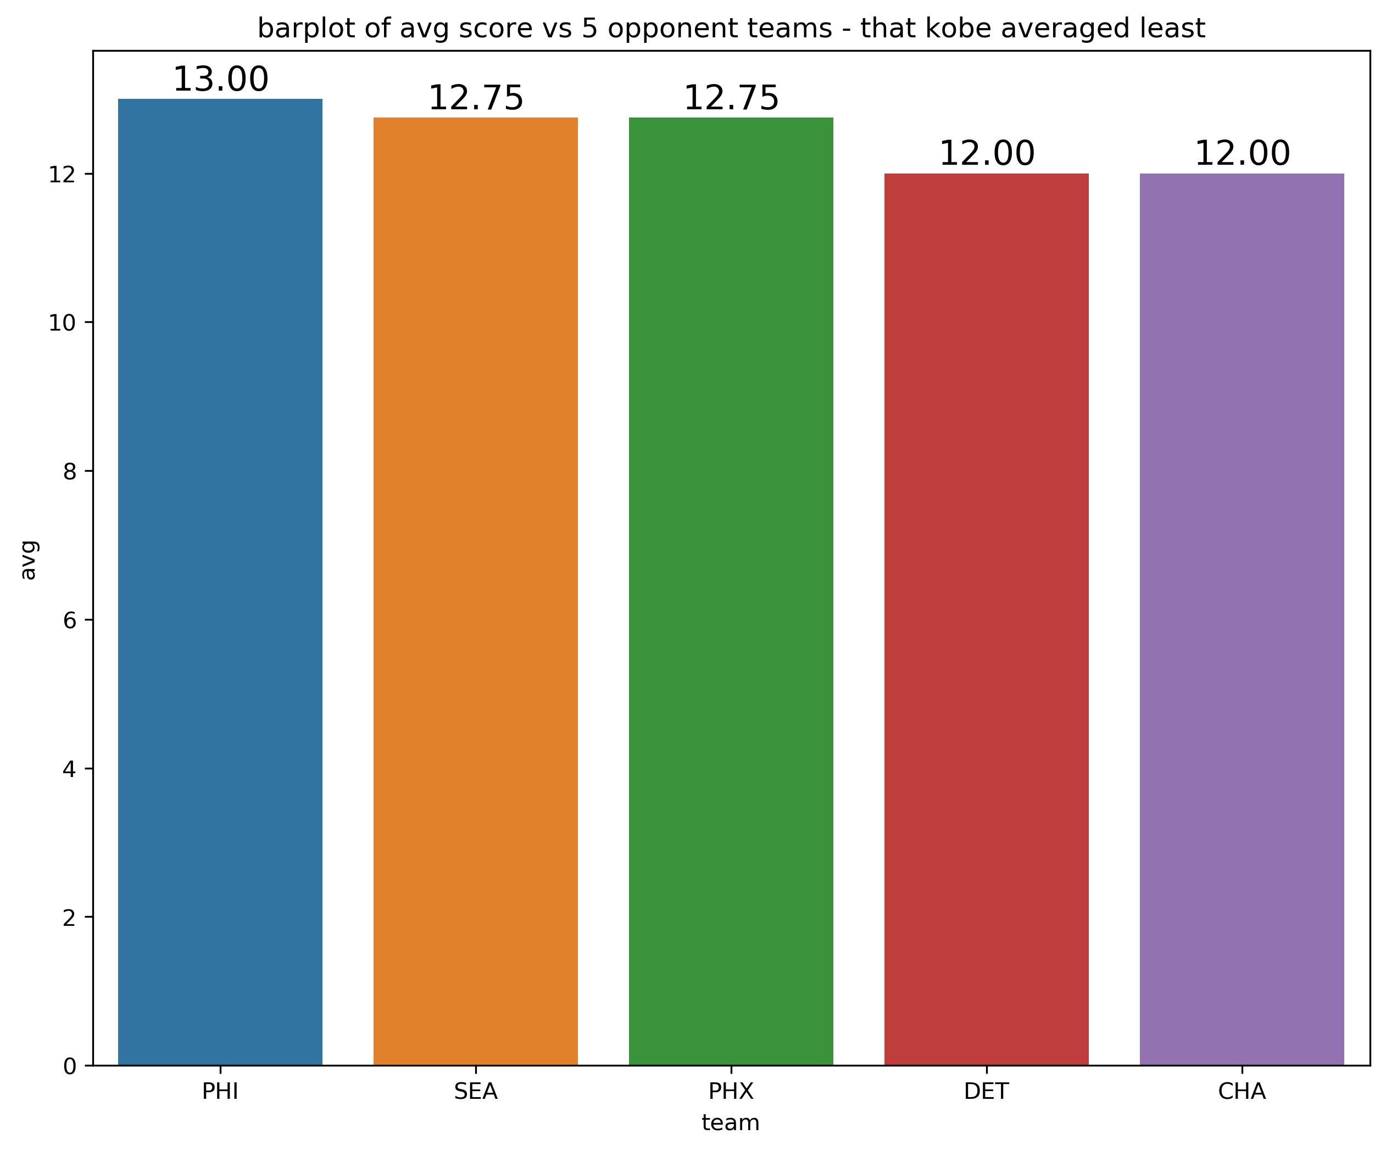
Opponent analysis - 2002
Above are the bar graphs showing the 5 teams against which kobe averaged the highest and 5 teams he averaged the least.
In the year 2002, the top team that kobe performed best is MEM(Memphis Grizzlies) and bottom team is CHA(Charlotte Hornets).

Slide 14
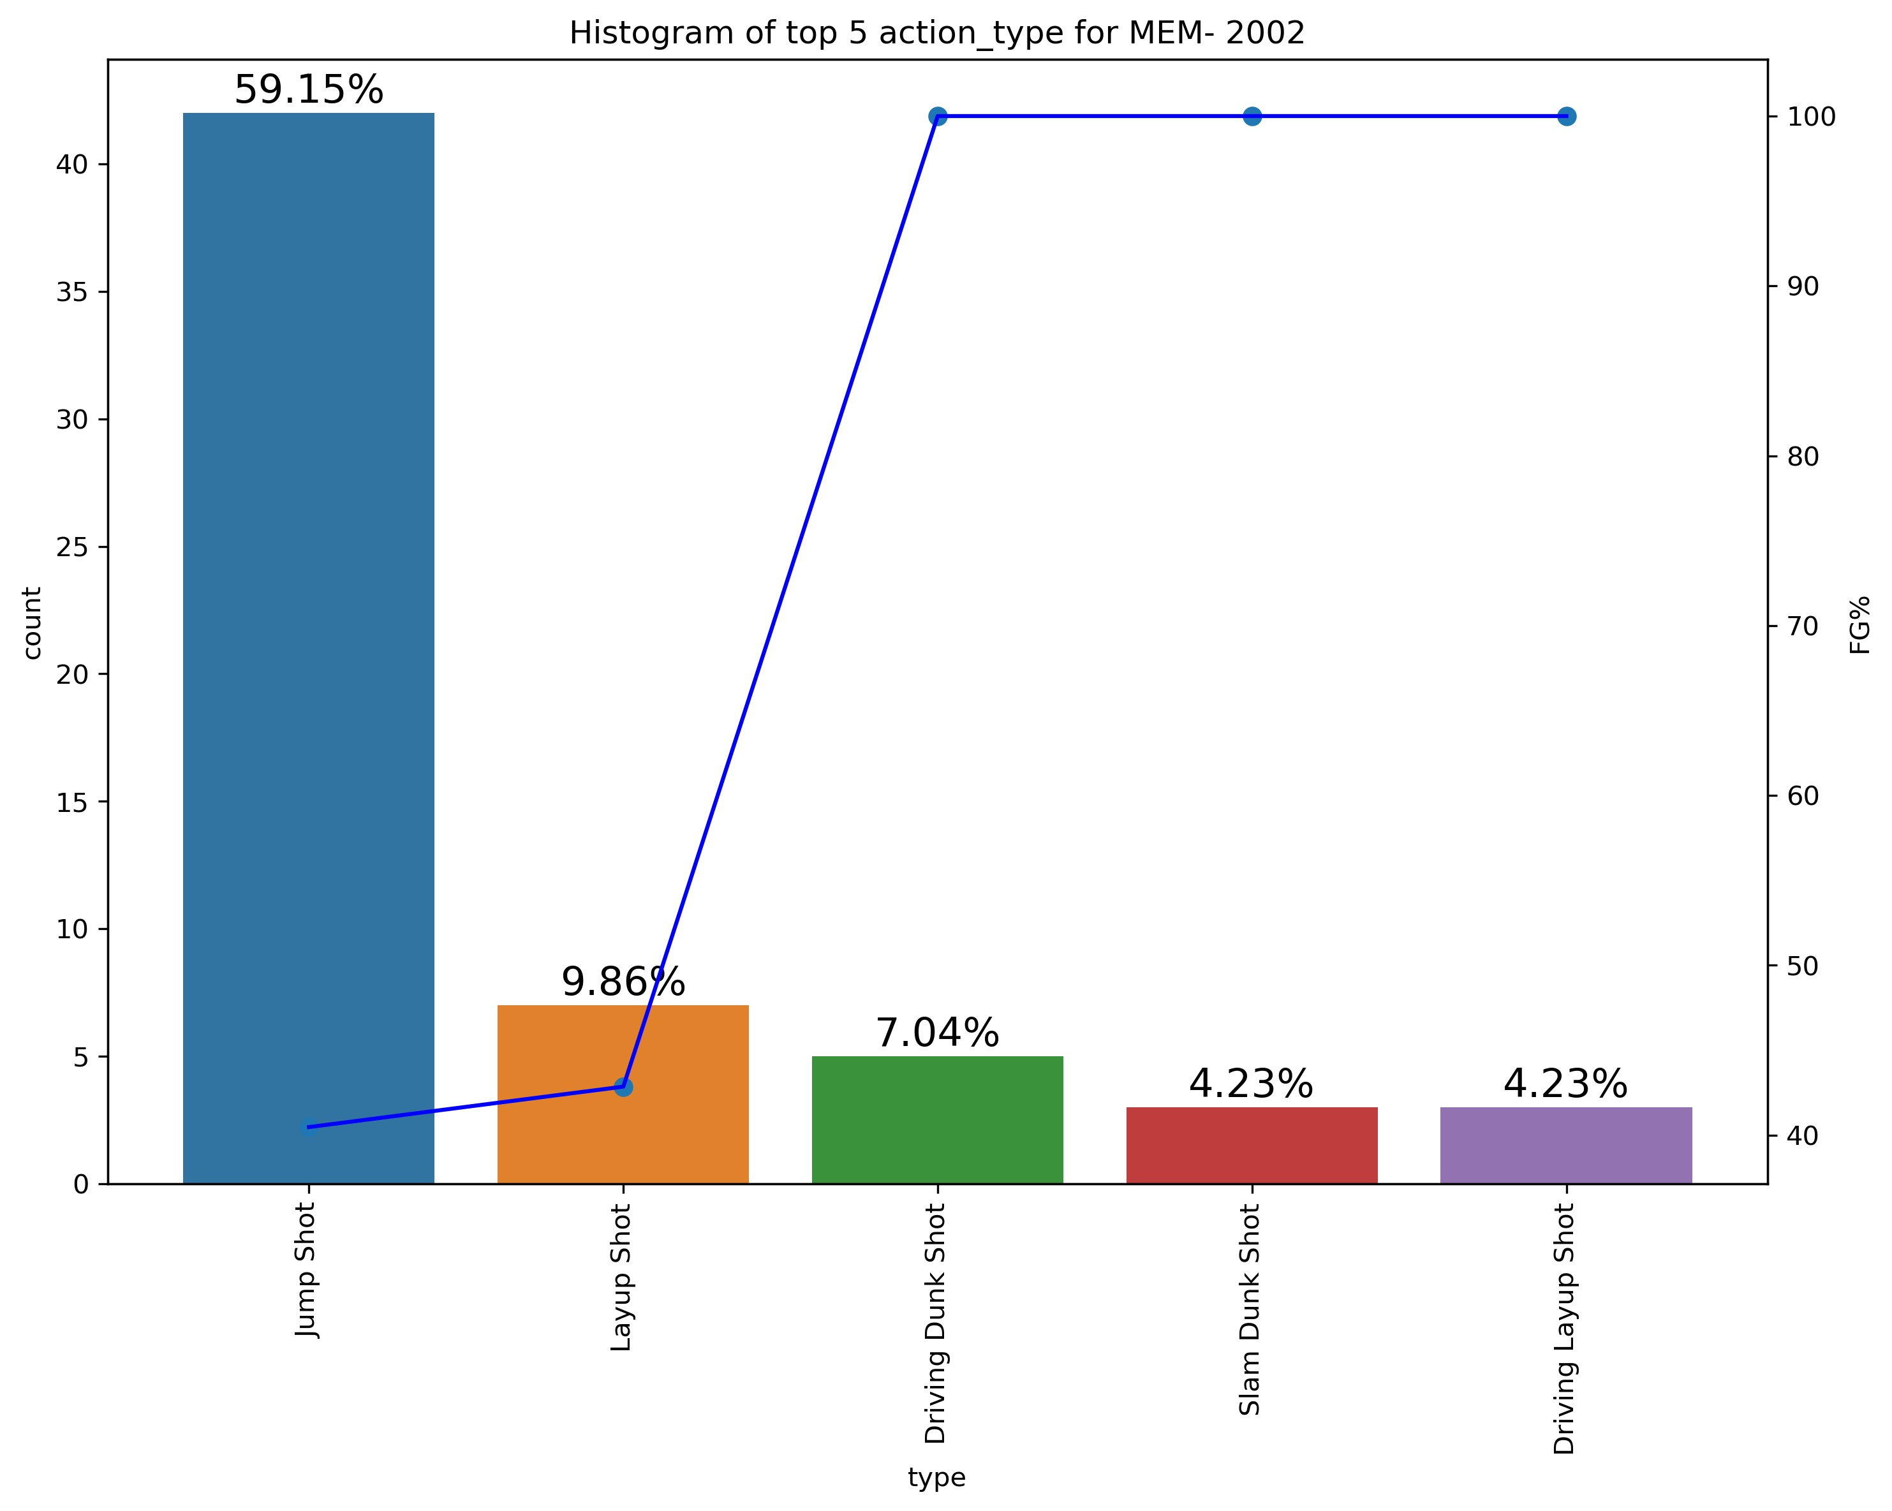
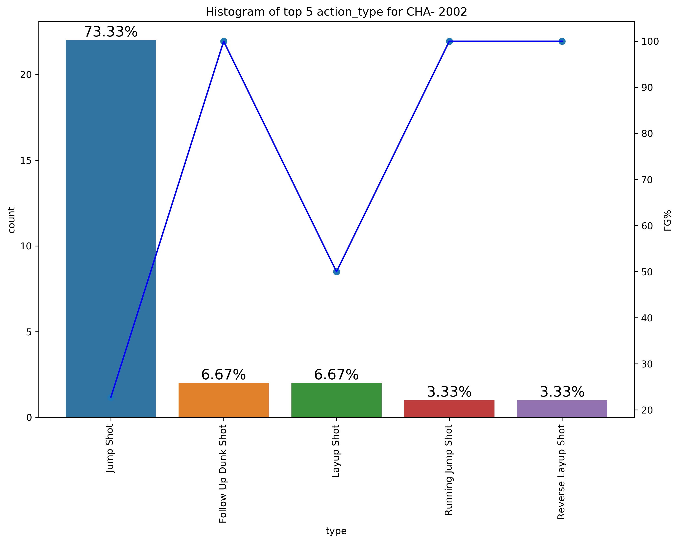
Opponent analysis - 2002
From the graph on the right, we can observe that against MEM his most used shot is jump shot (59.15%) with FG% of around 40% followed by layup shot.
But though used less the dunks have highest FG%, so they are most effective shot type.
From the graph on the left, we can observe that against CHA his most used shot is jump shot (73.33%) with FG% of around 20% followed by dunk shot.
From this we can observe that this team have not allowed him to shoot the jump shot with high accuracy, possibly by assigning him a taller opponent.

Slide 15
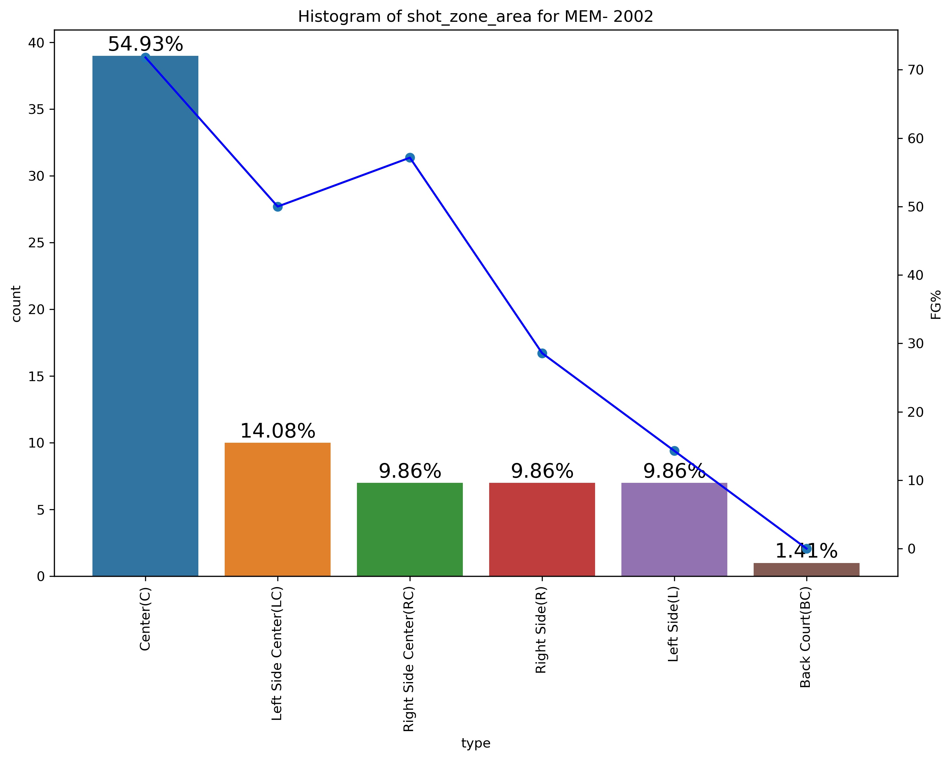
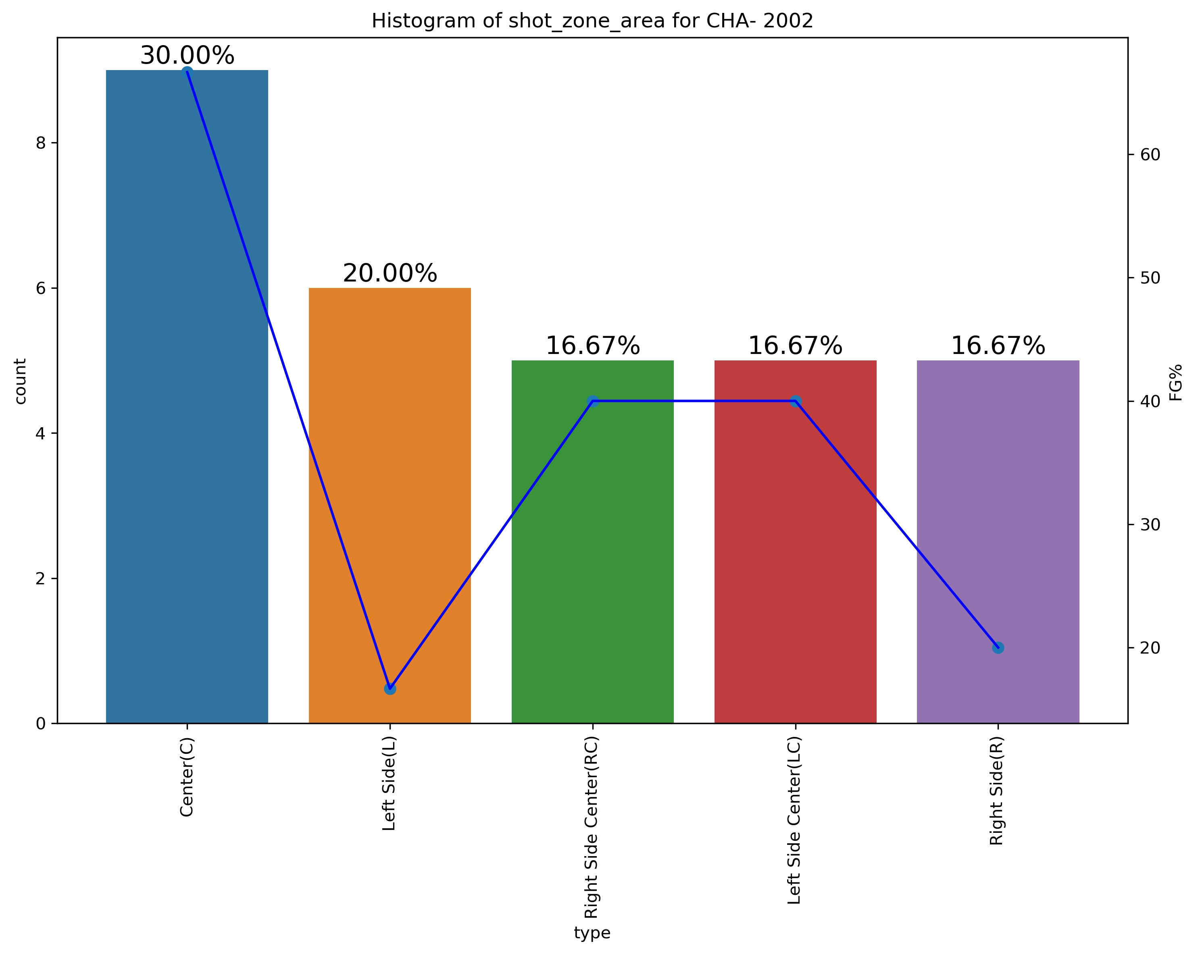
Opponent analysis - 2002
From both the graphs we can observe that kobe shoots mostly from the Center area, also with highest FG% followed by his shots from left side so the takeaway points is to force him away from these areas to right side if possible.

Slide 16
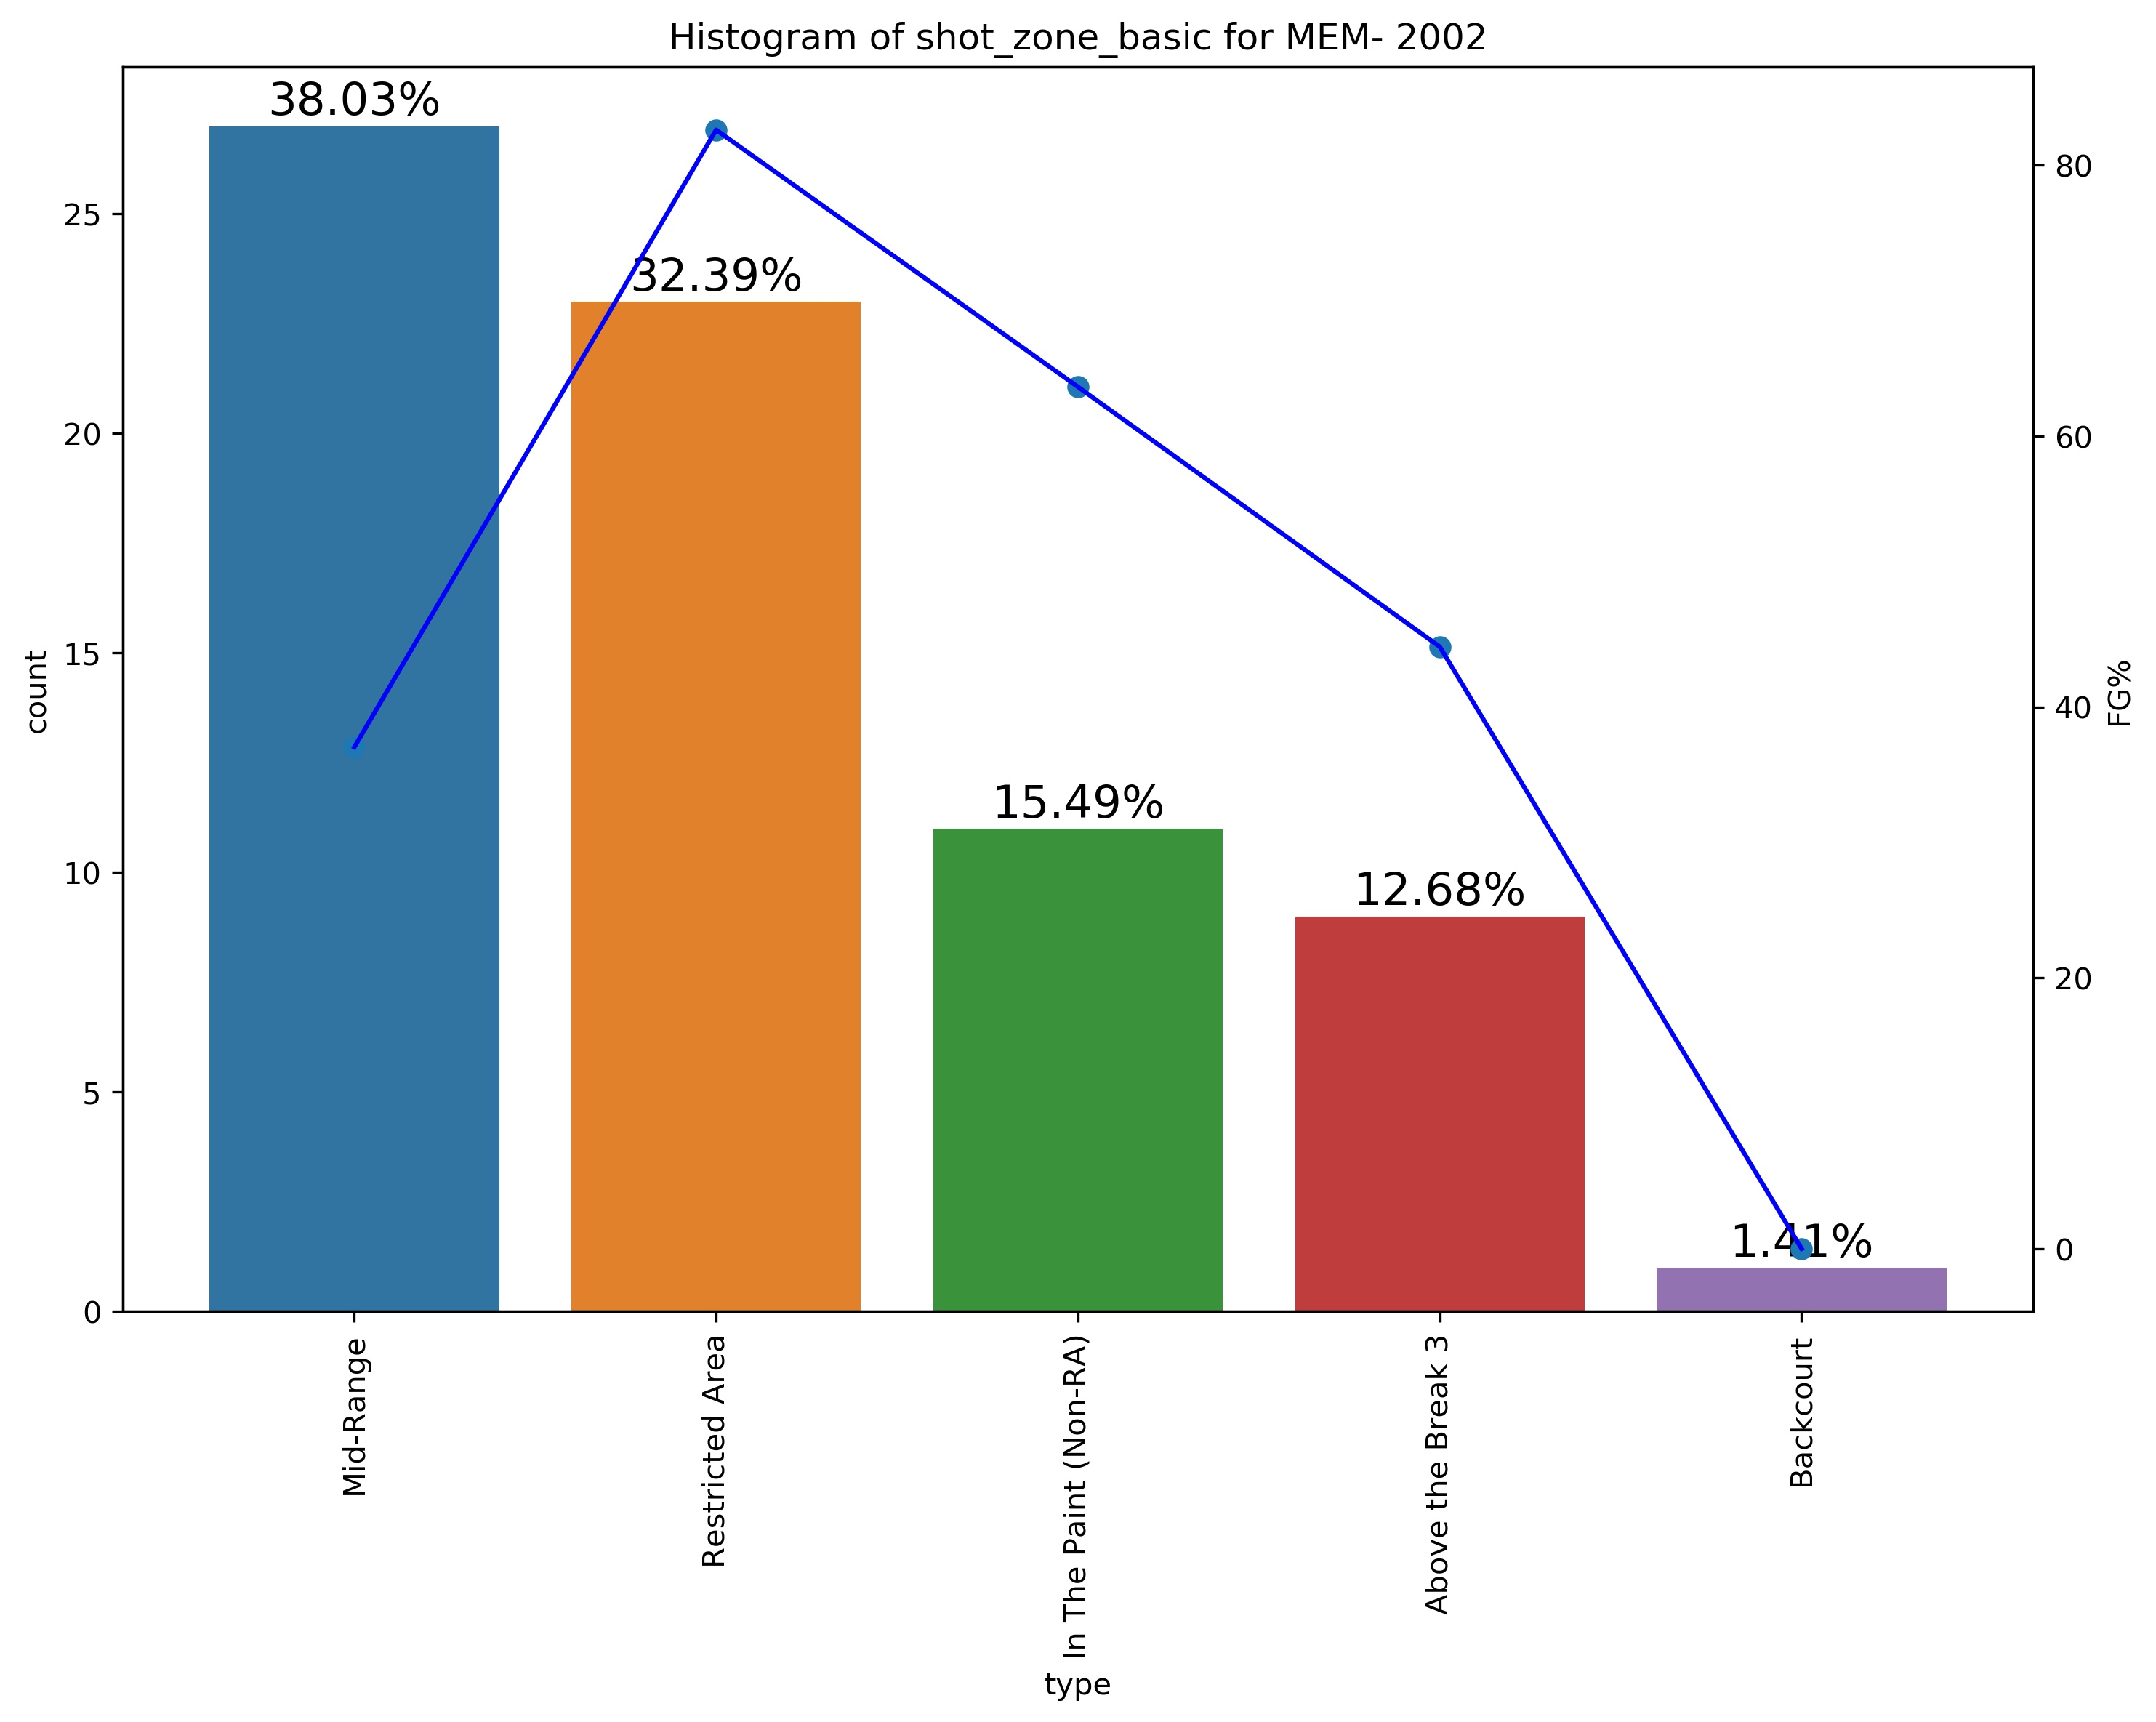
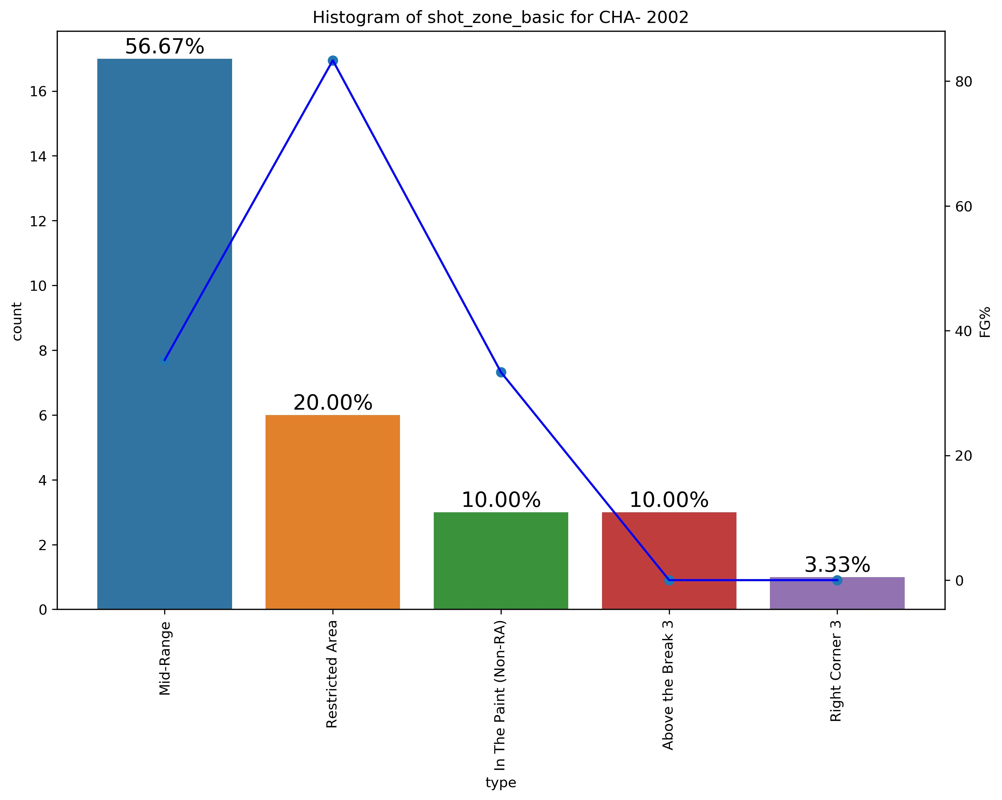
Opponent analysis - 2002
From both the graphs we can observe that kobe shoots mostly from Mid-Range area, followed by from Restricted Area also with highest FG% so the takeaway points is to force him away to shoot from longer regions.

Slide 17
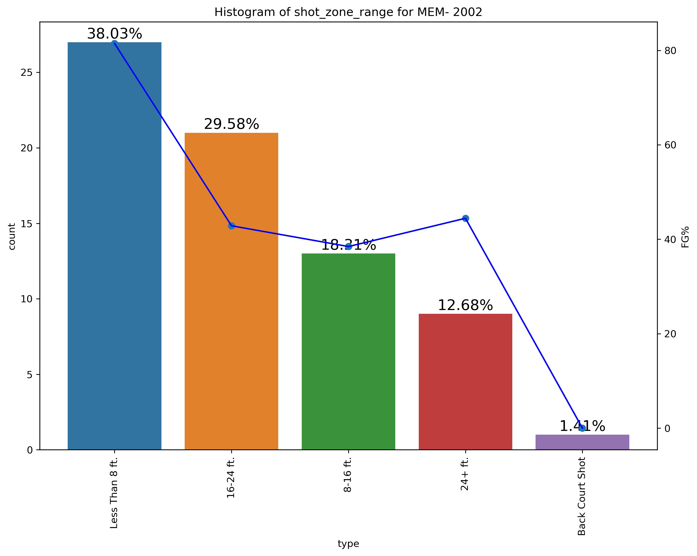
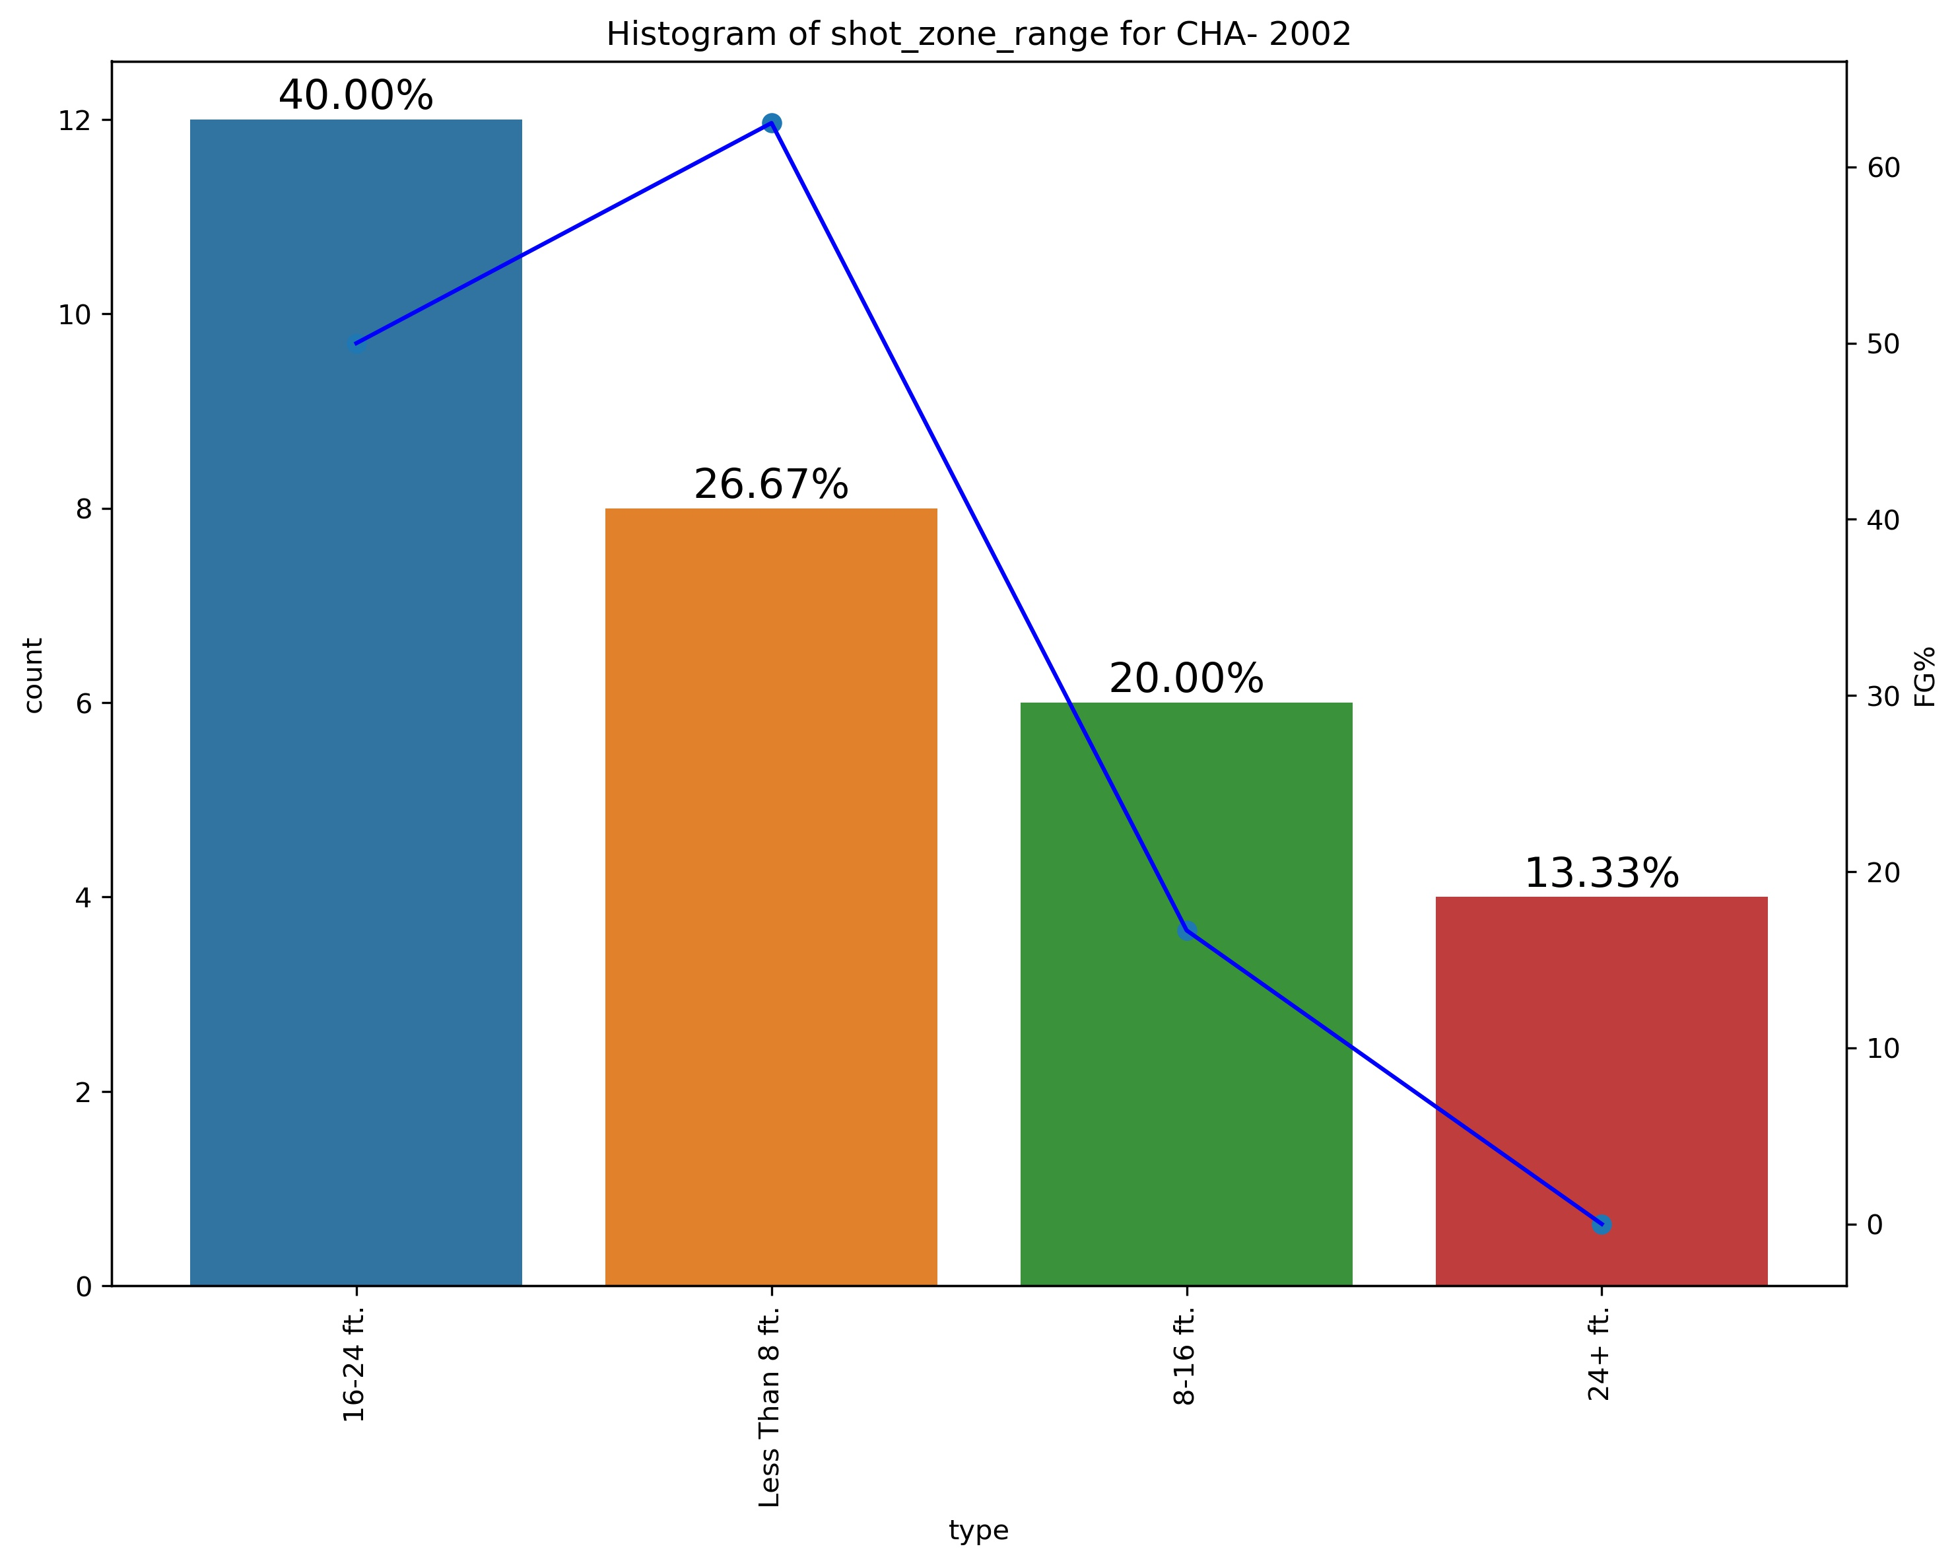
Opponent analysis - 2002
From the graphs on right, we can observe that kobe shot most shots from ‘Less than 8ft’ against MEM and from graph below we can see that CHA team restricted kobe from shooting from Less than 8ft and that allowed them to make kobe less effective.
So the takeway point is to guard him so that he does not reach Less than 8ft area from where he is most effective.

Slide 18
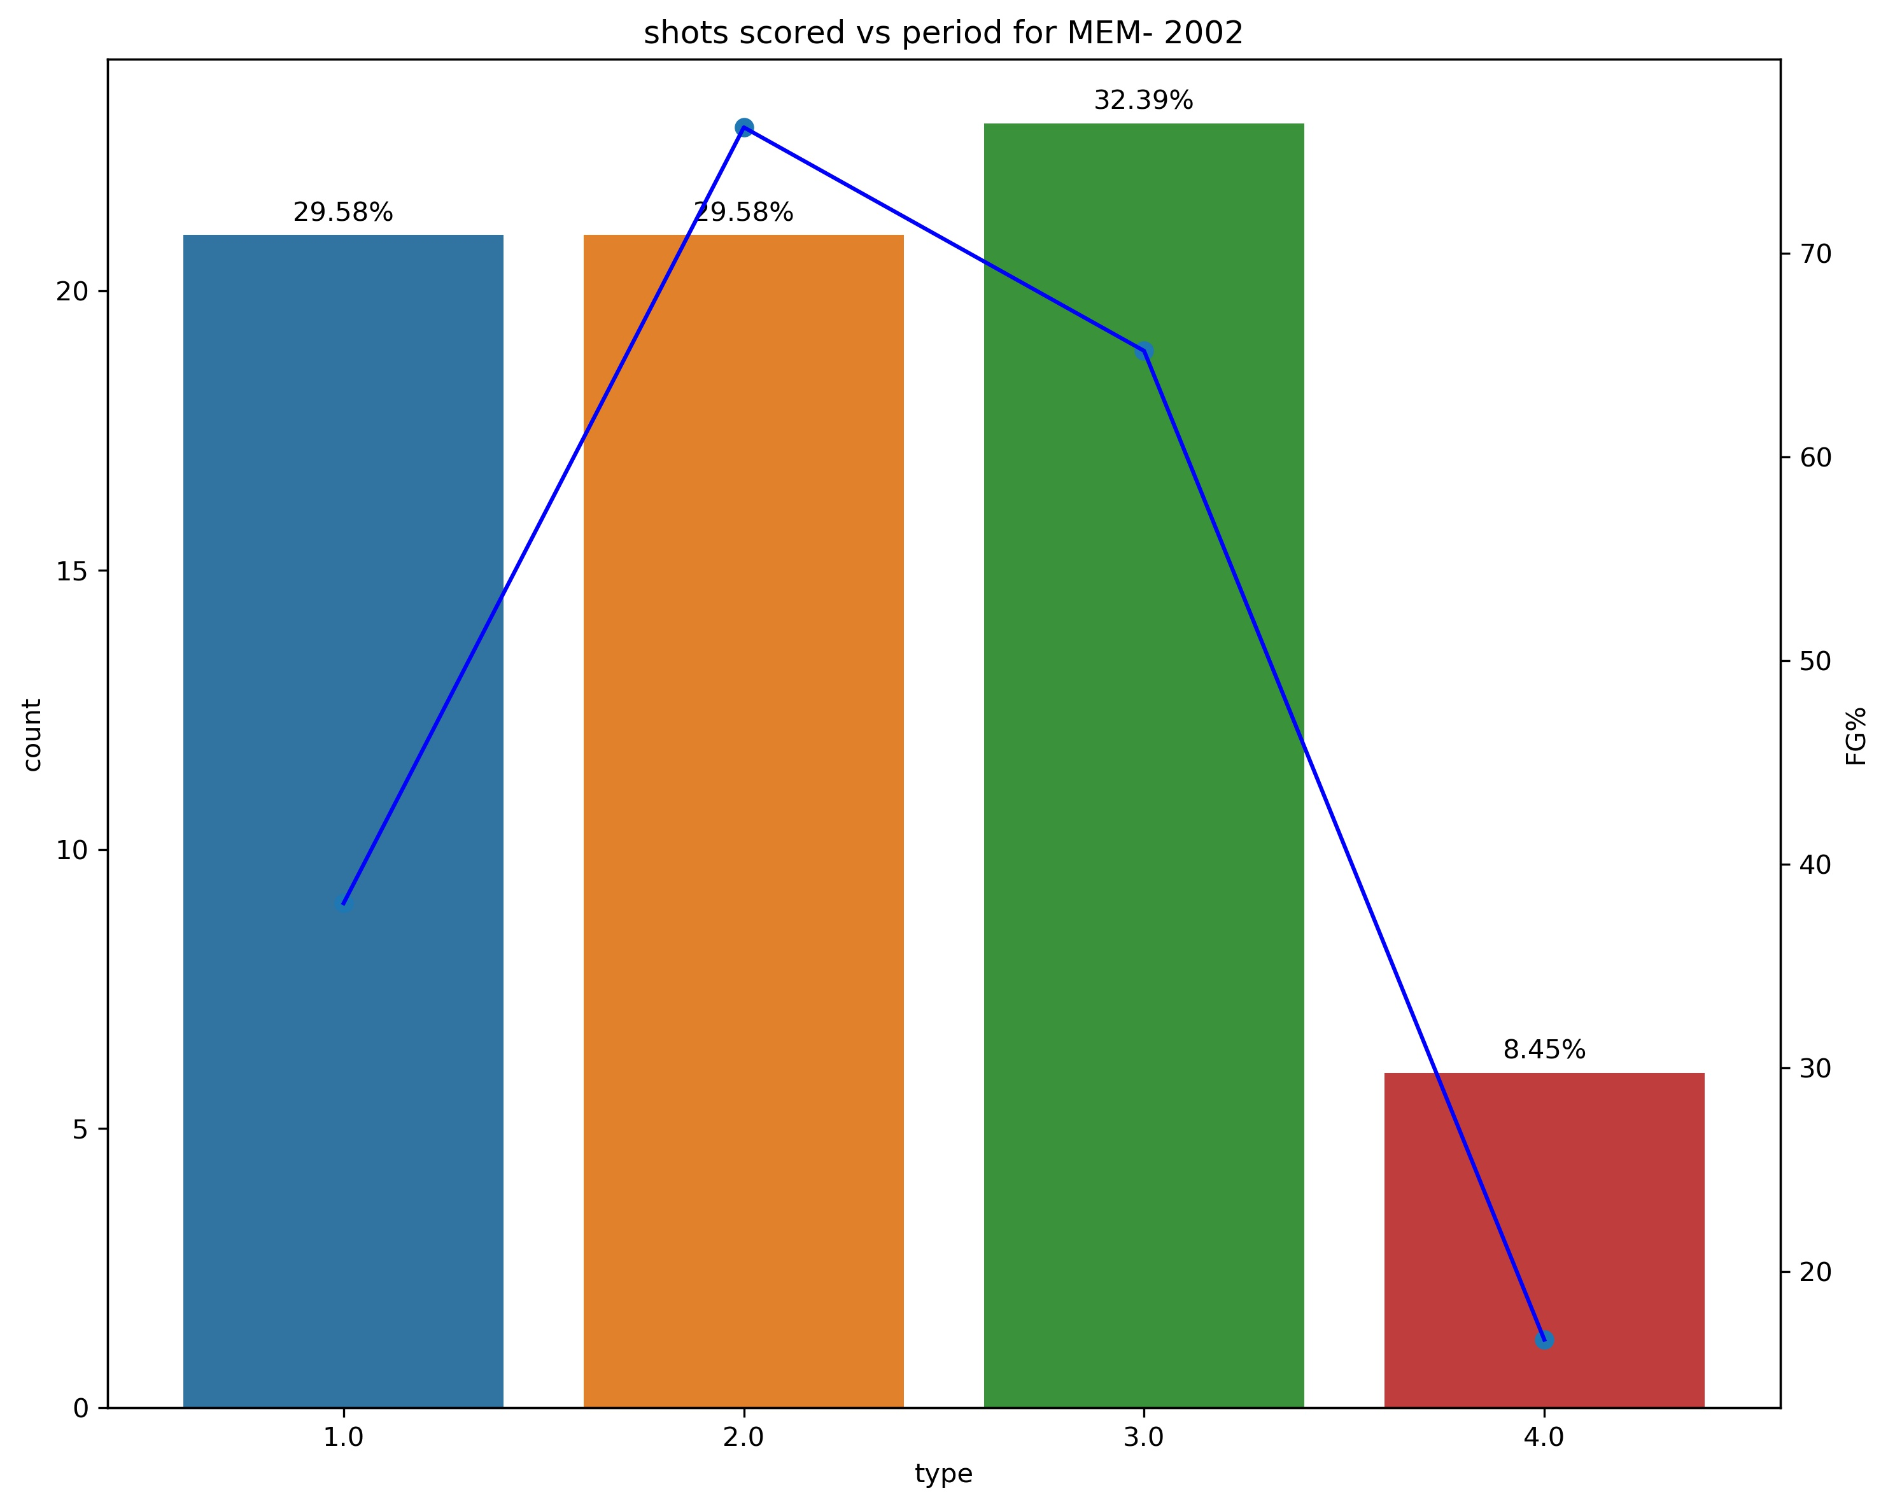
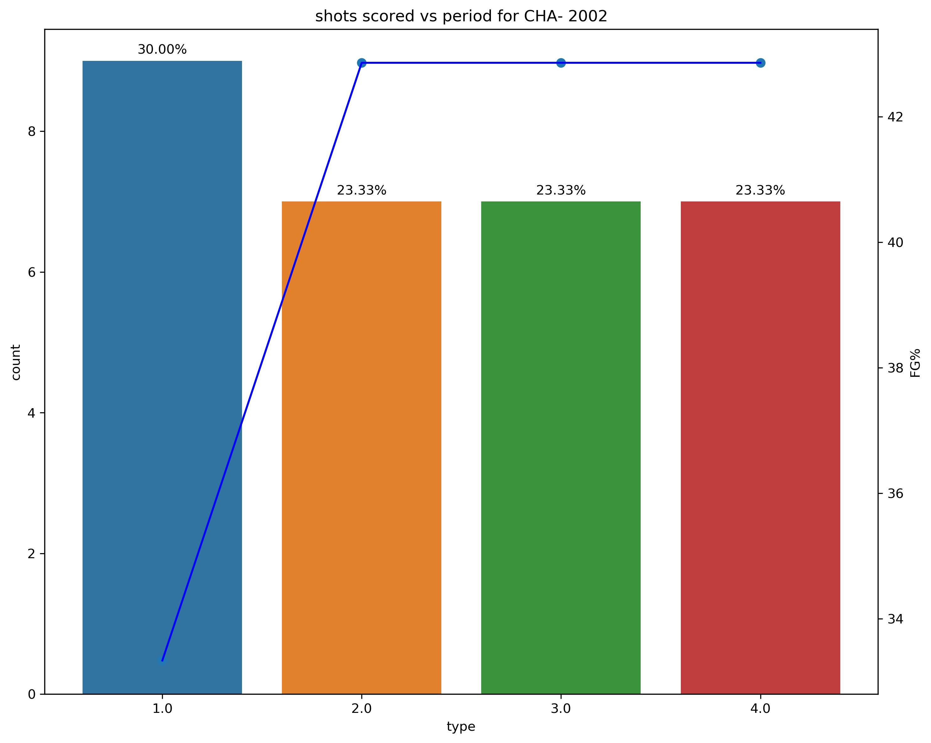
Opponent analysis - 2002
Against MEM we can observe that kobe played evenly in 1st and 2nd quarter and was most active in 3rd quarter and had highest FG% in 2nd quarter
Against CHA we can observe that they have restricted him in 2nd and 3rd quarter with much less FG% in all quarters, so the takeaway point is to put more pressure in 1st quarter and make him score with less accuracy where he has more energy so he might perform less in following quarters where he has less energy and also additional pressure to perform more to compensate form 1st quarter.

Slide 19
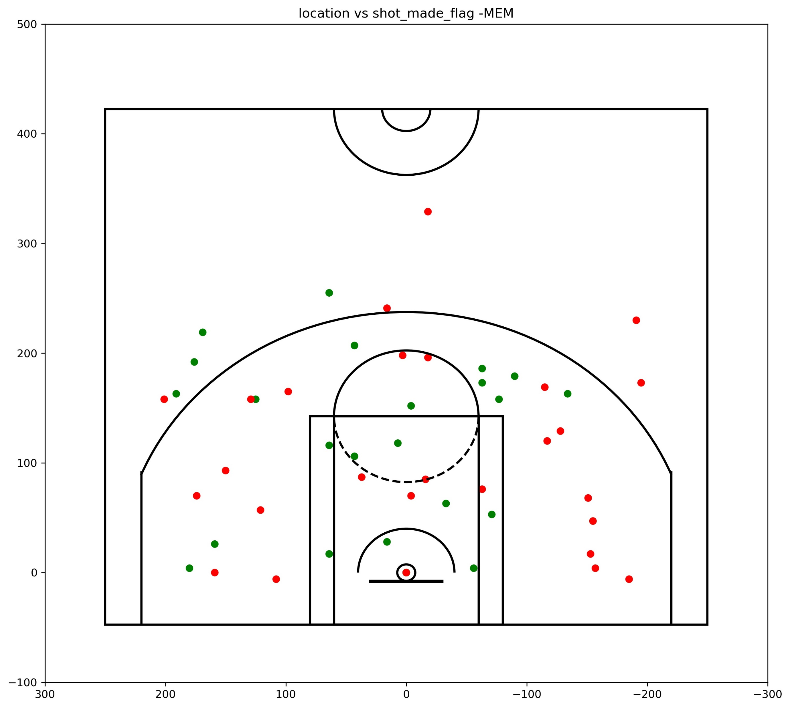
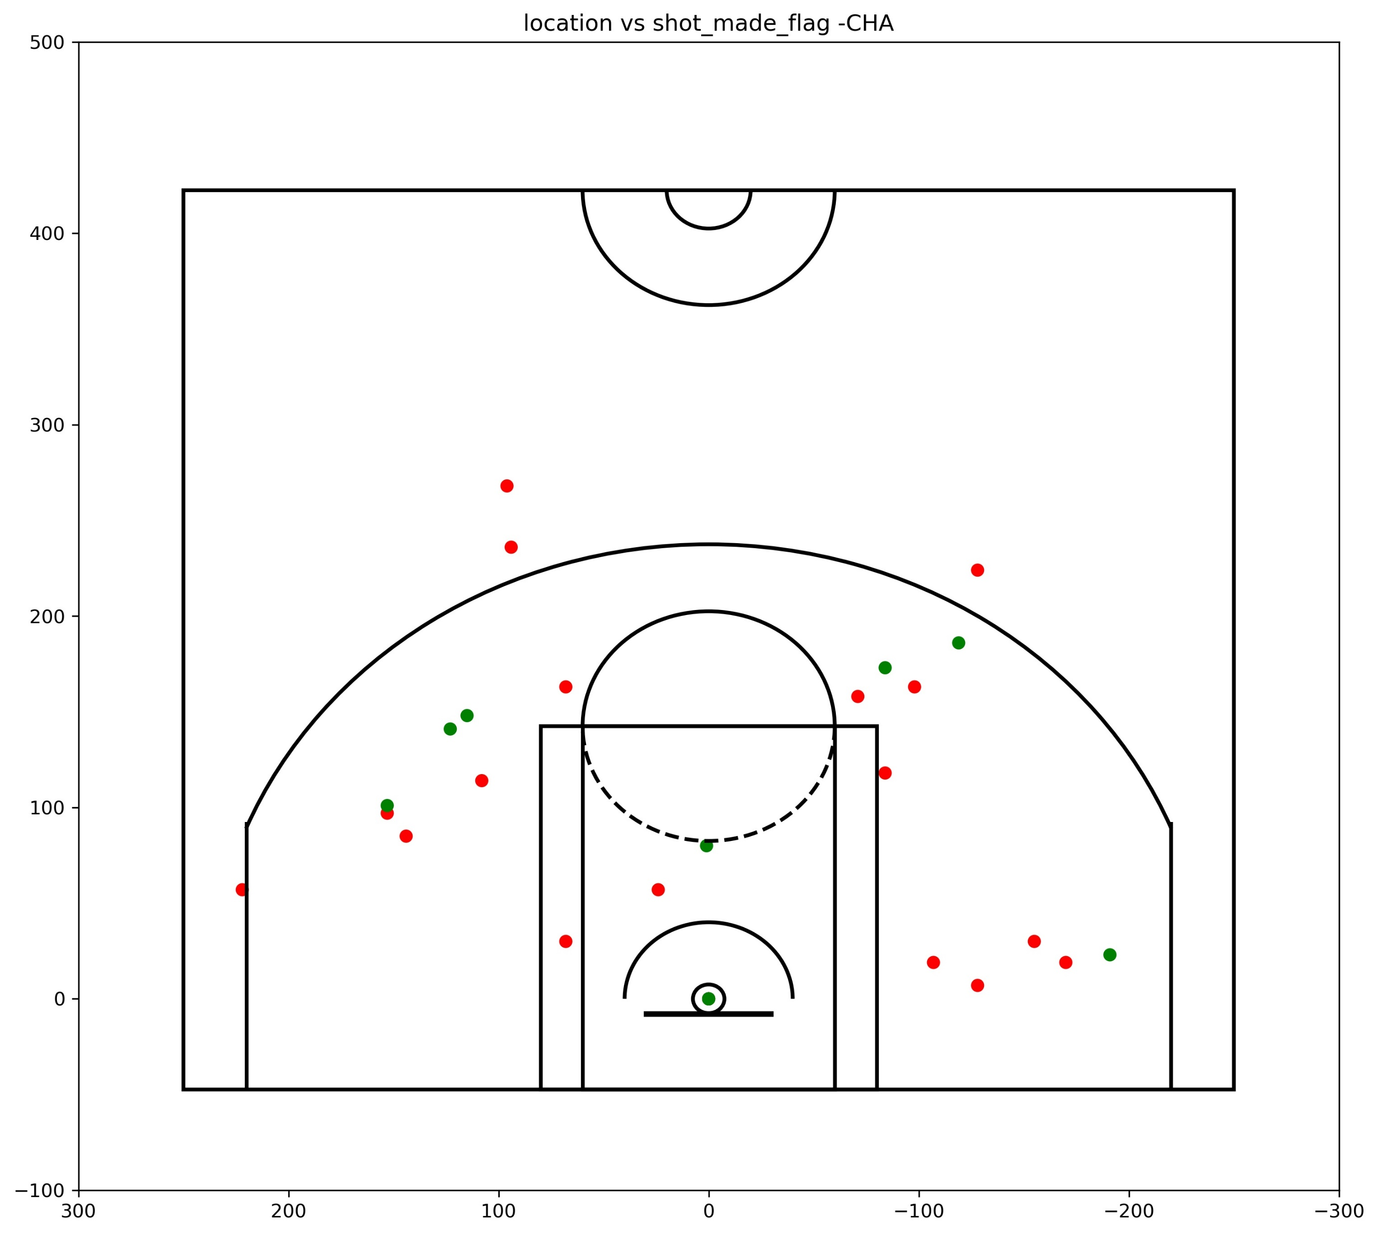
Opponent analysis - 2002

Slide 20
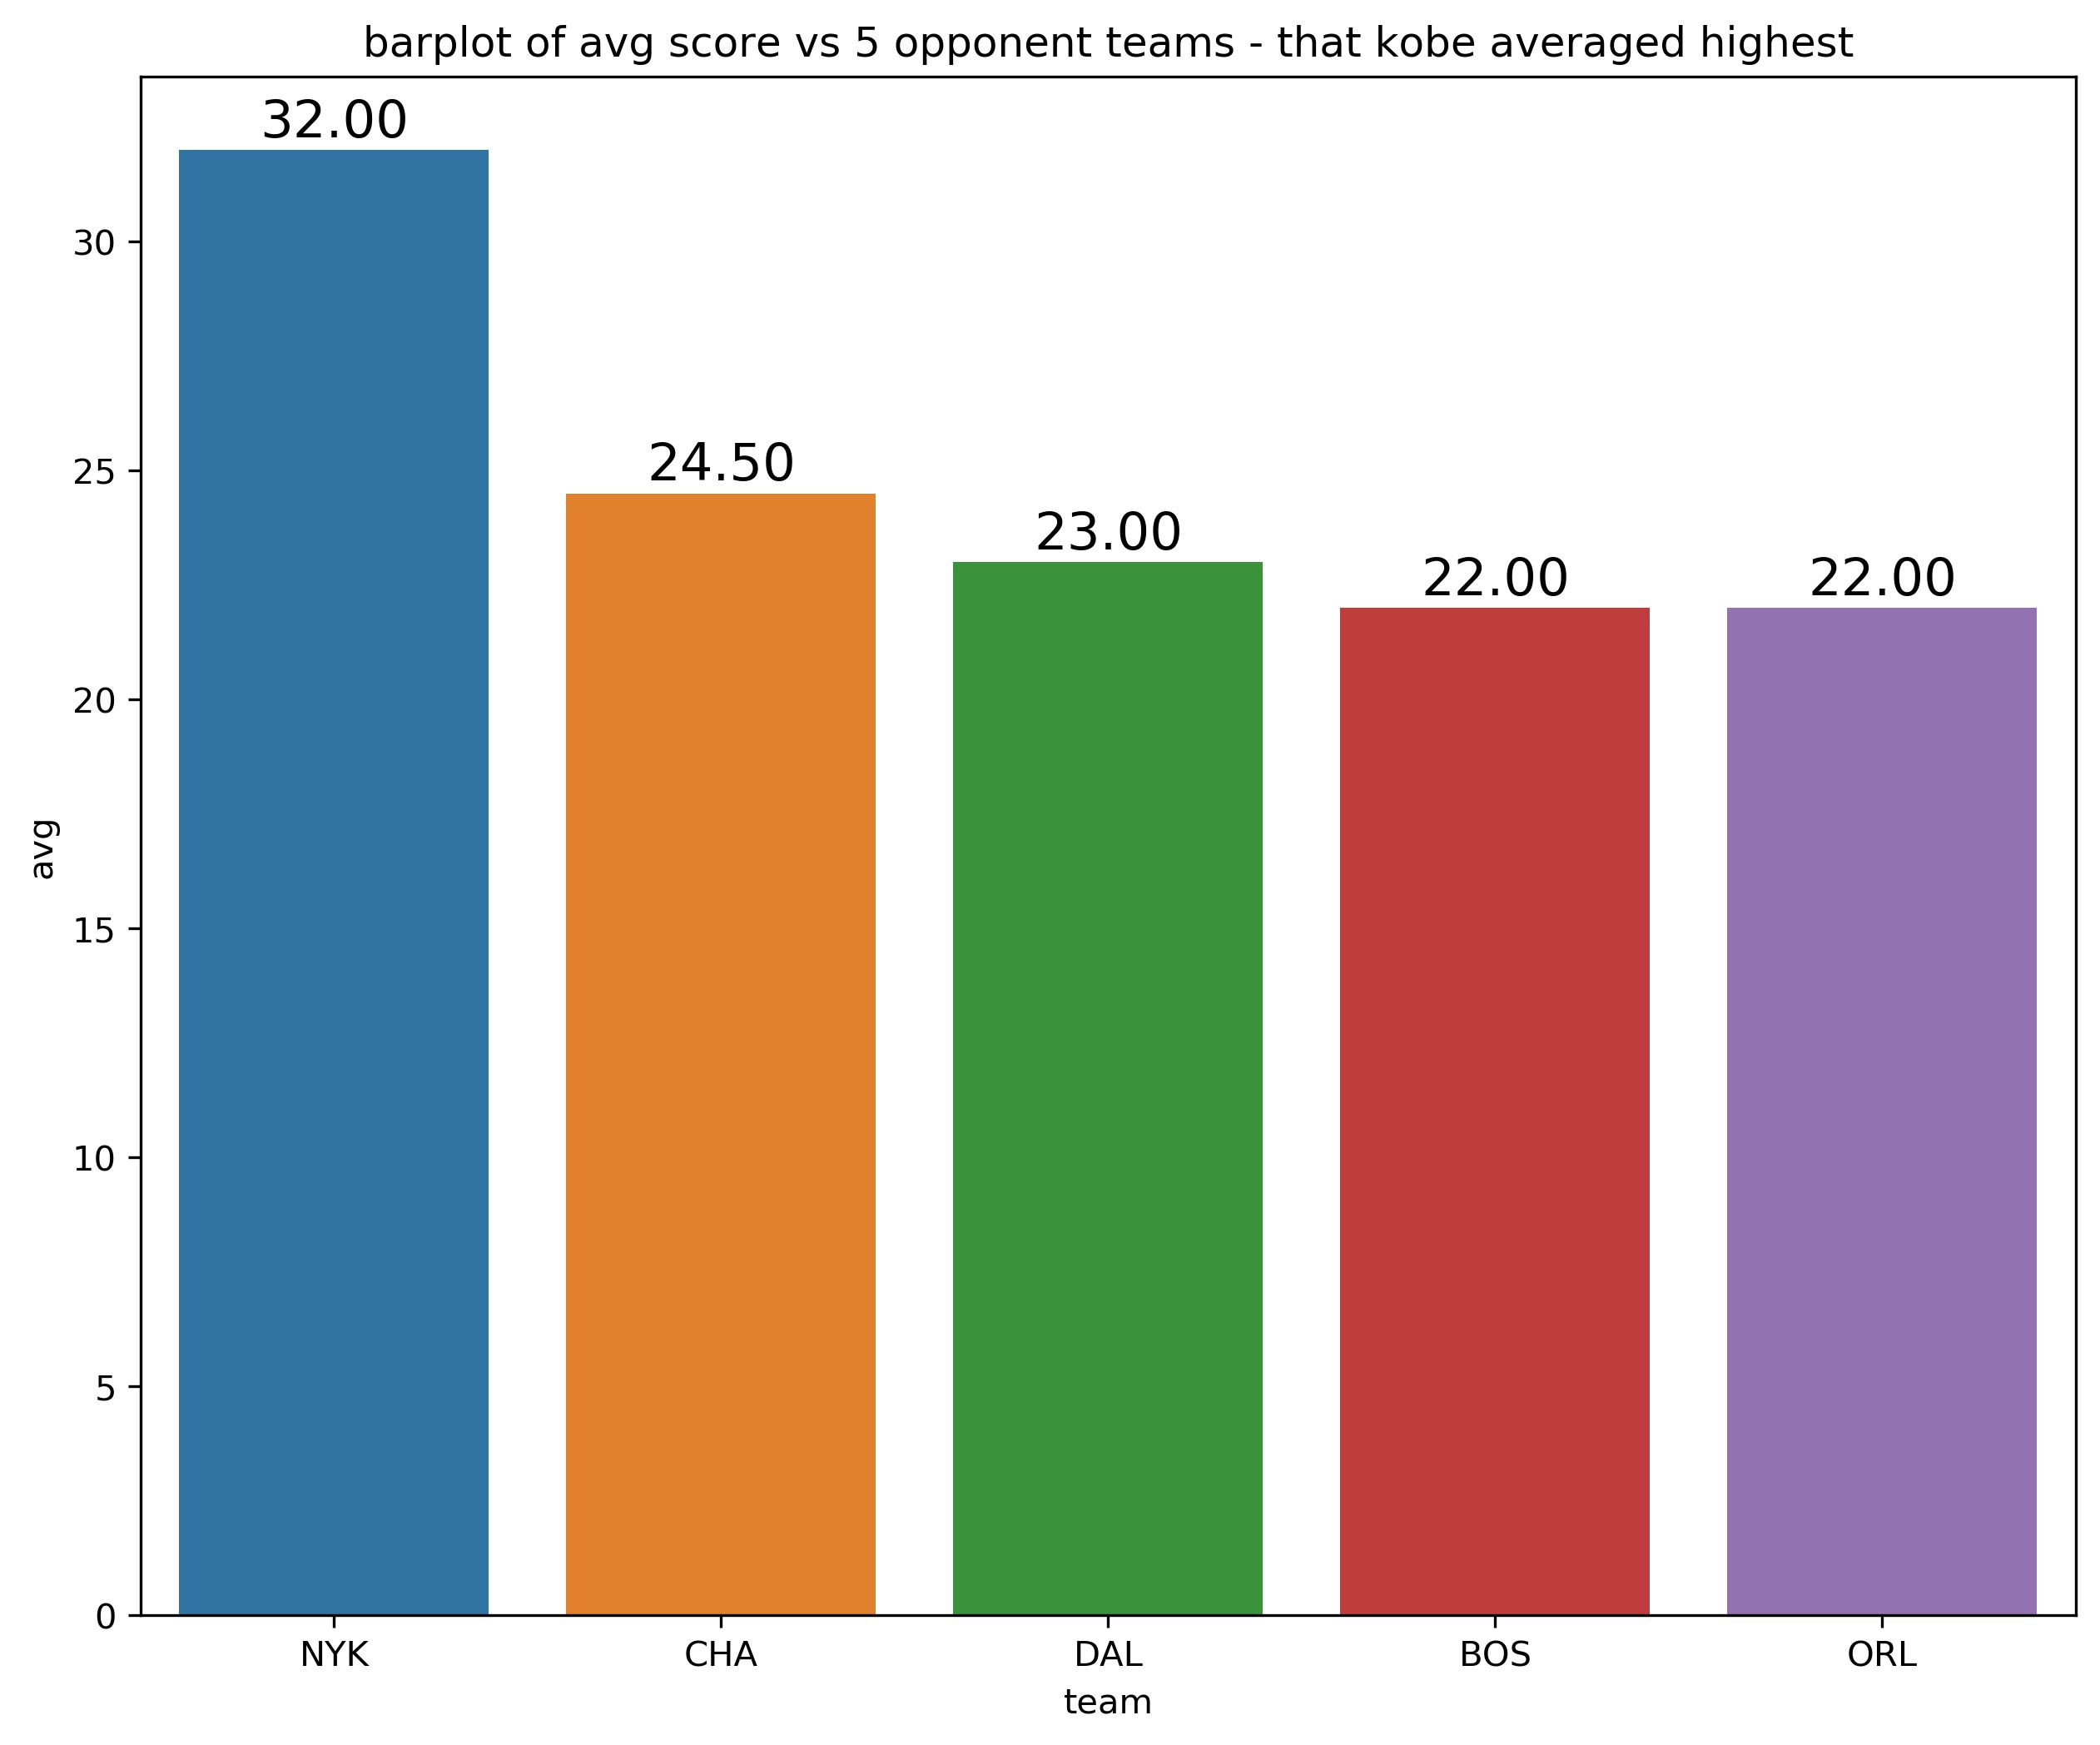
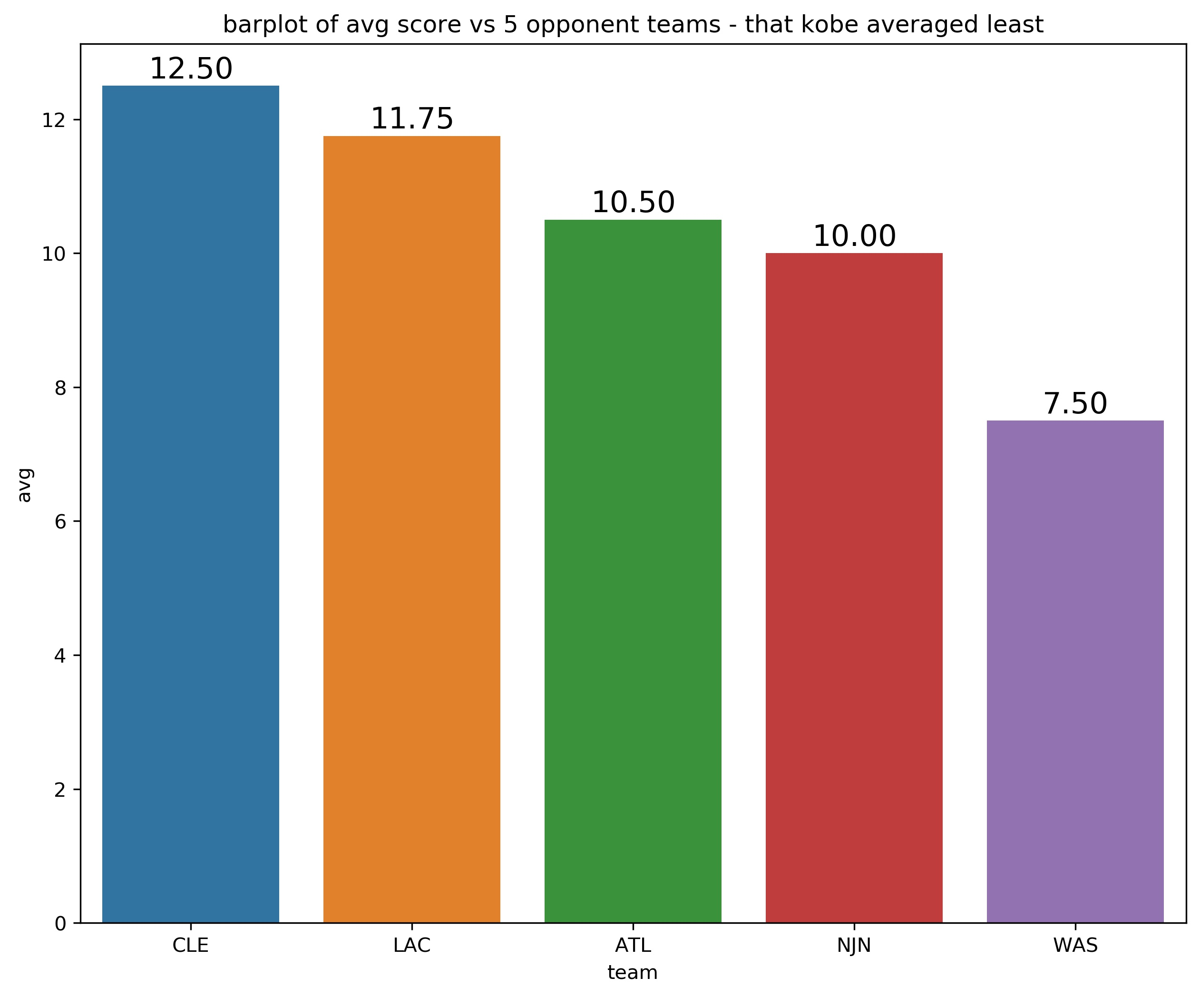
Opponent analysis - 2009
Above are the bar graphs showing the 5 teams against which kobe averaged the highest and 5 teams he averaged the least.
In the year 2009, the top team that kobe performed best is NYK(New York Knicks) and bottom team is WAS(Washington Wizards).

Slide 21
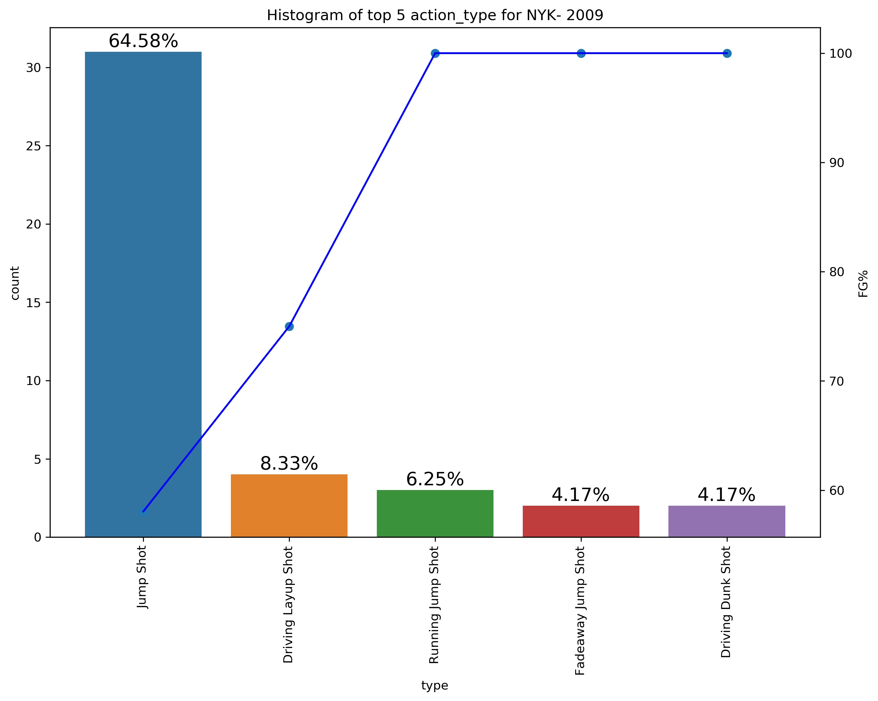
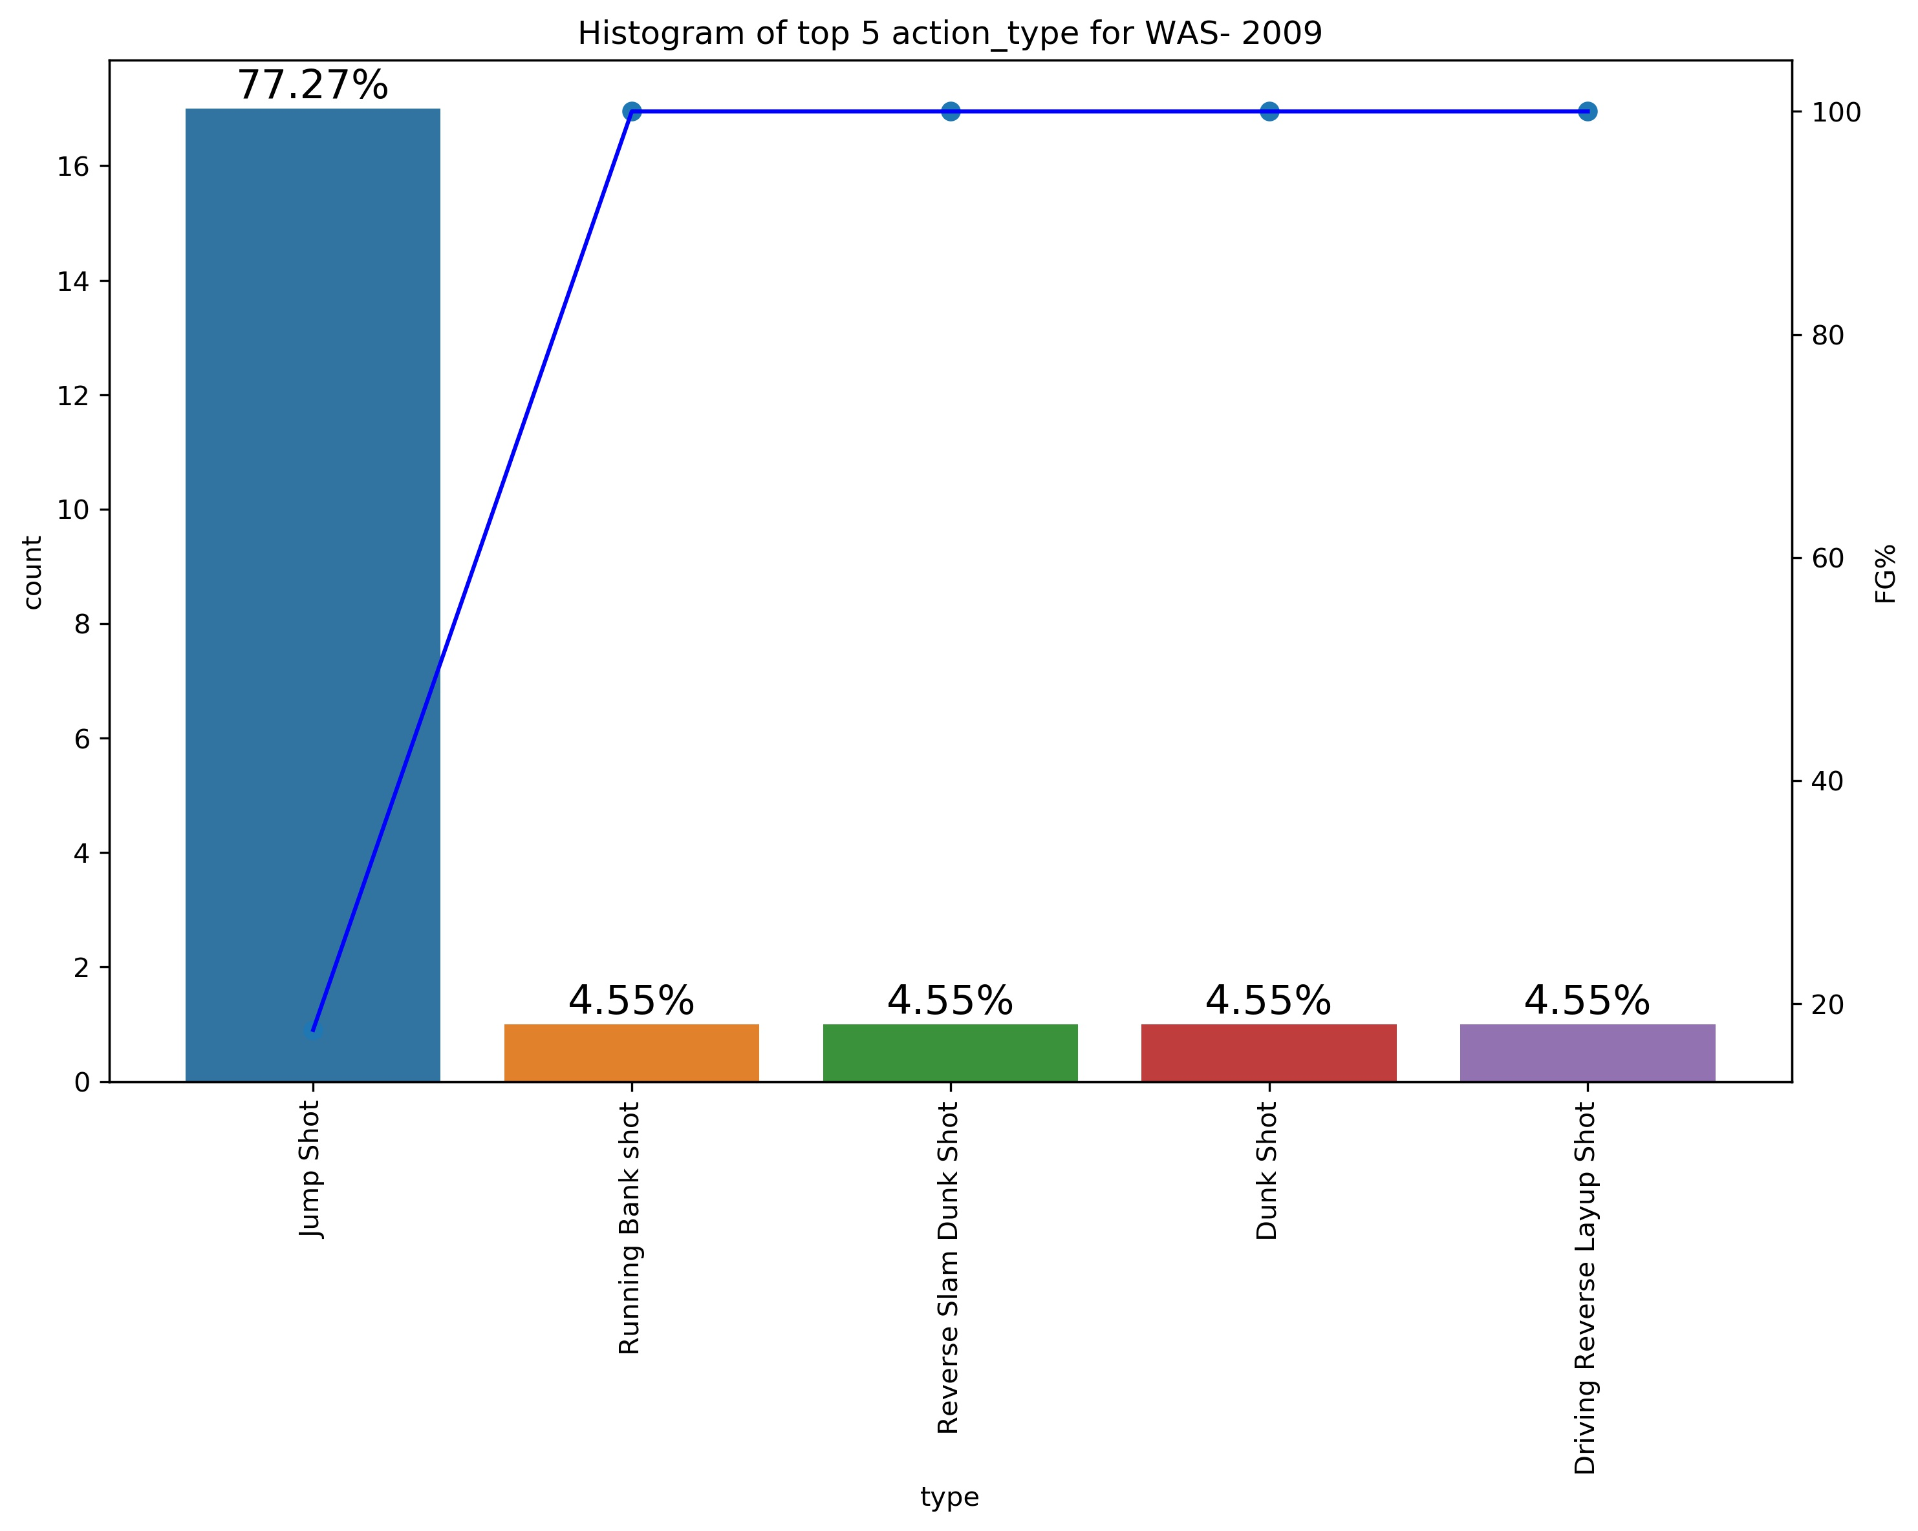
Opponent analysis - 2009
From the graph on the right, we can observe that against NYK his most used shot is jump shot (64.58%) with FG% of around 50% followed by layup shot.
But though used less the dunks have highest FG%, so they are most effective shot type.
From the graph on the left, we can observe that against WAS his most used shot is jump shot (77.27%) with FG% of around 20% followed by running Bank shot.
From this we can observe that this team have not allowed him to shoot the jump shot with high accuracy, possibly by assigning him a taller opponent.

Slide 22
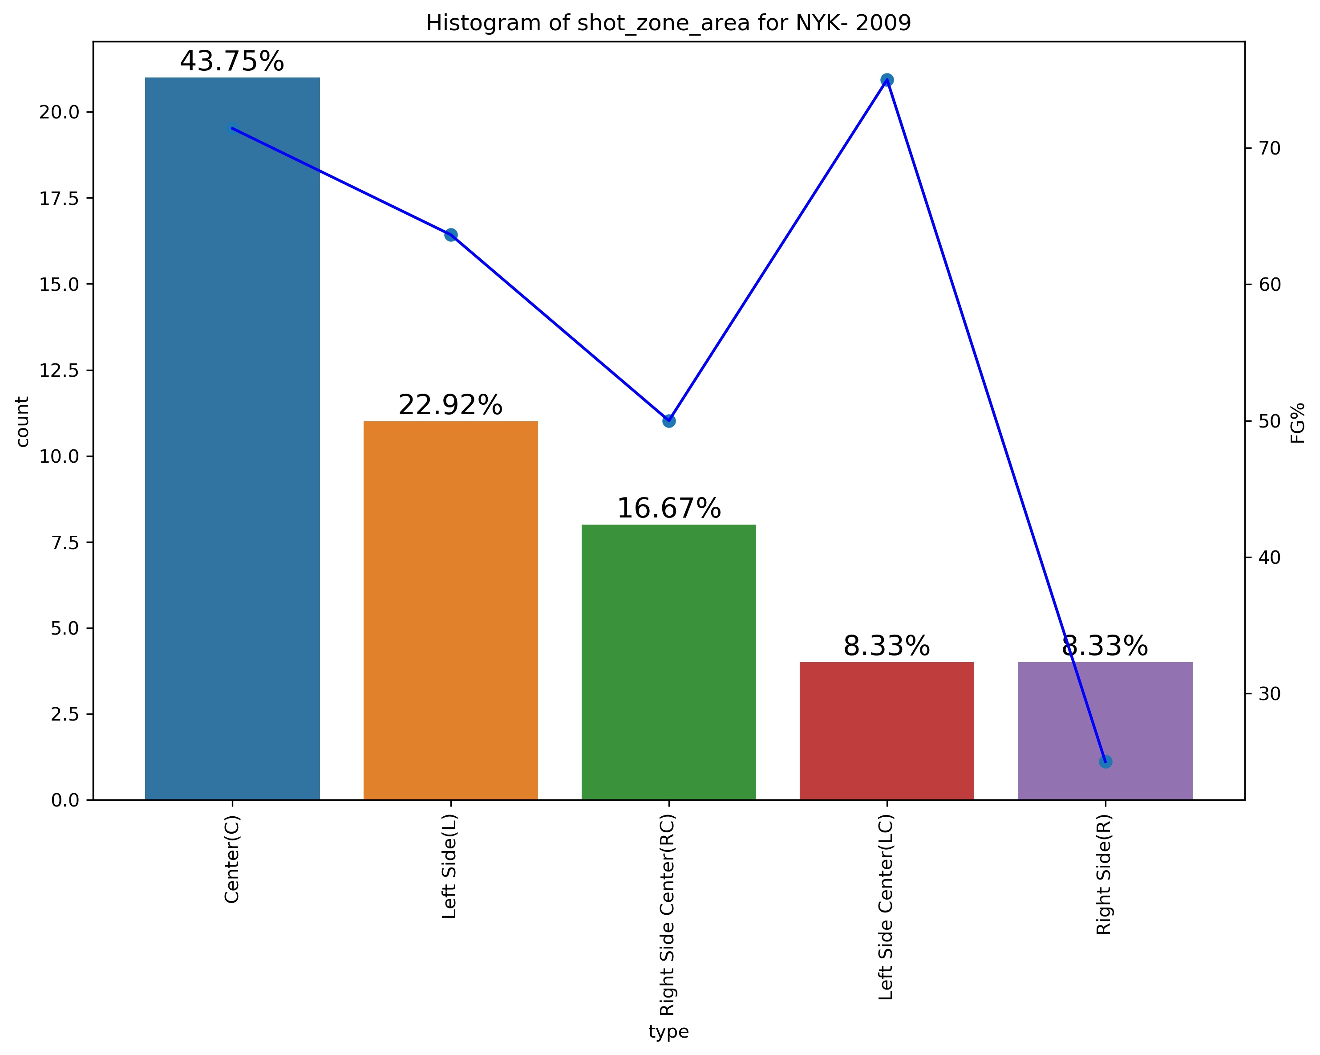
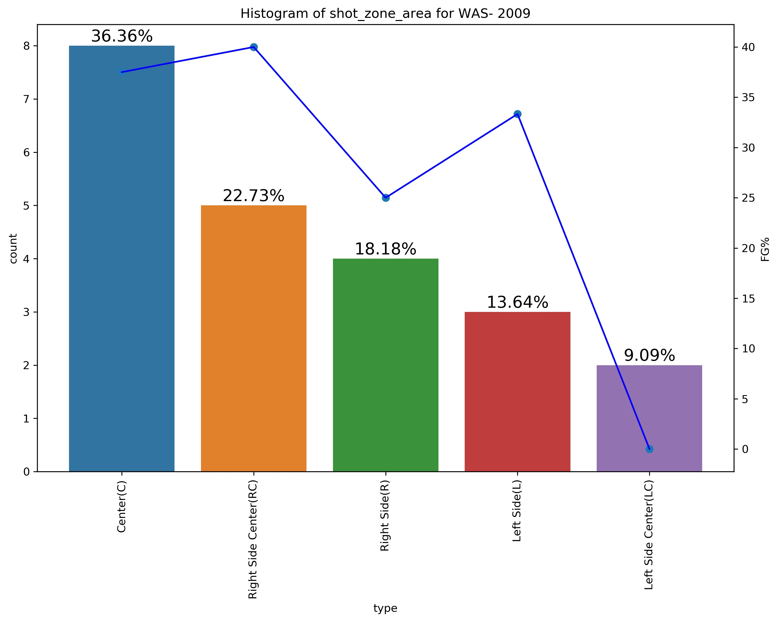
Opponent analysis - 2009
From both the graphs we can observe that kobe shoots mostly from the Center area, also with highest FG% followed by his shots from left side so the takeaway points is to force him away from these areas to right side if possible which WAS was able to do effectively and restrict him to low average.

Slide 23
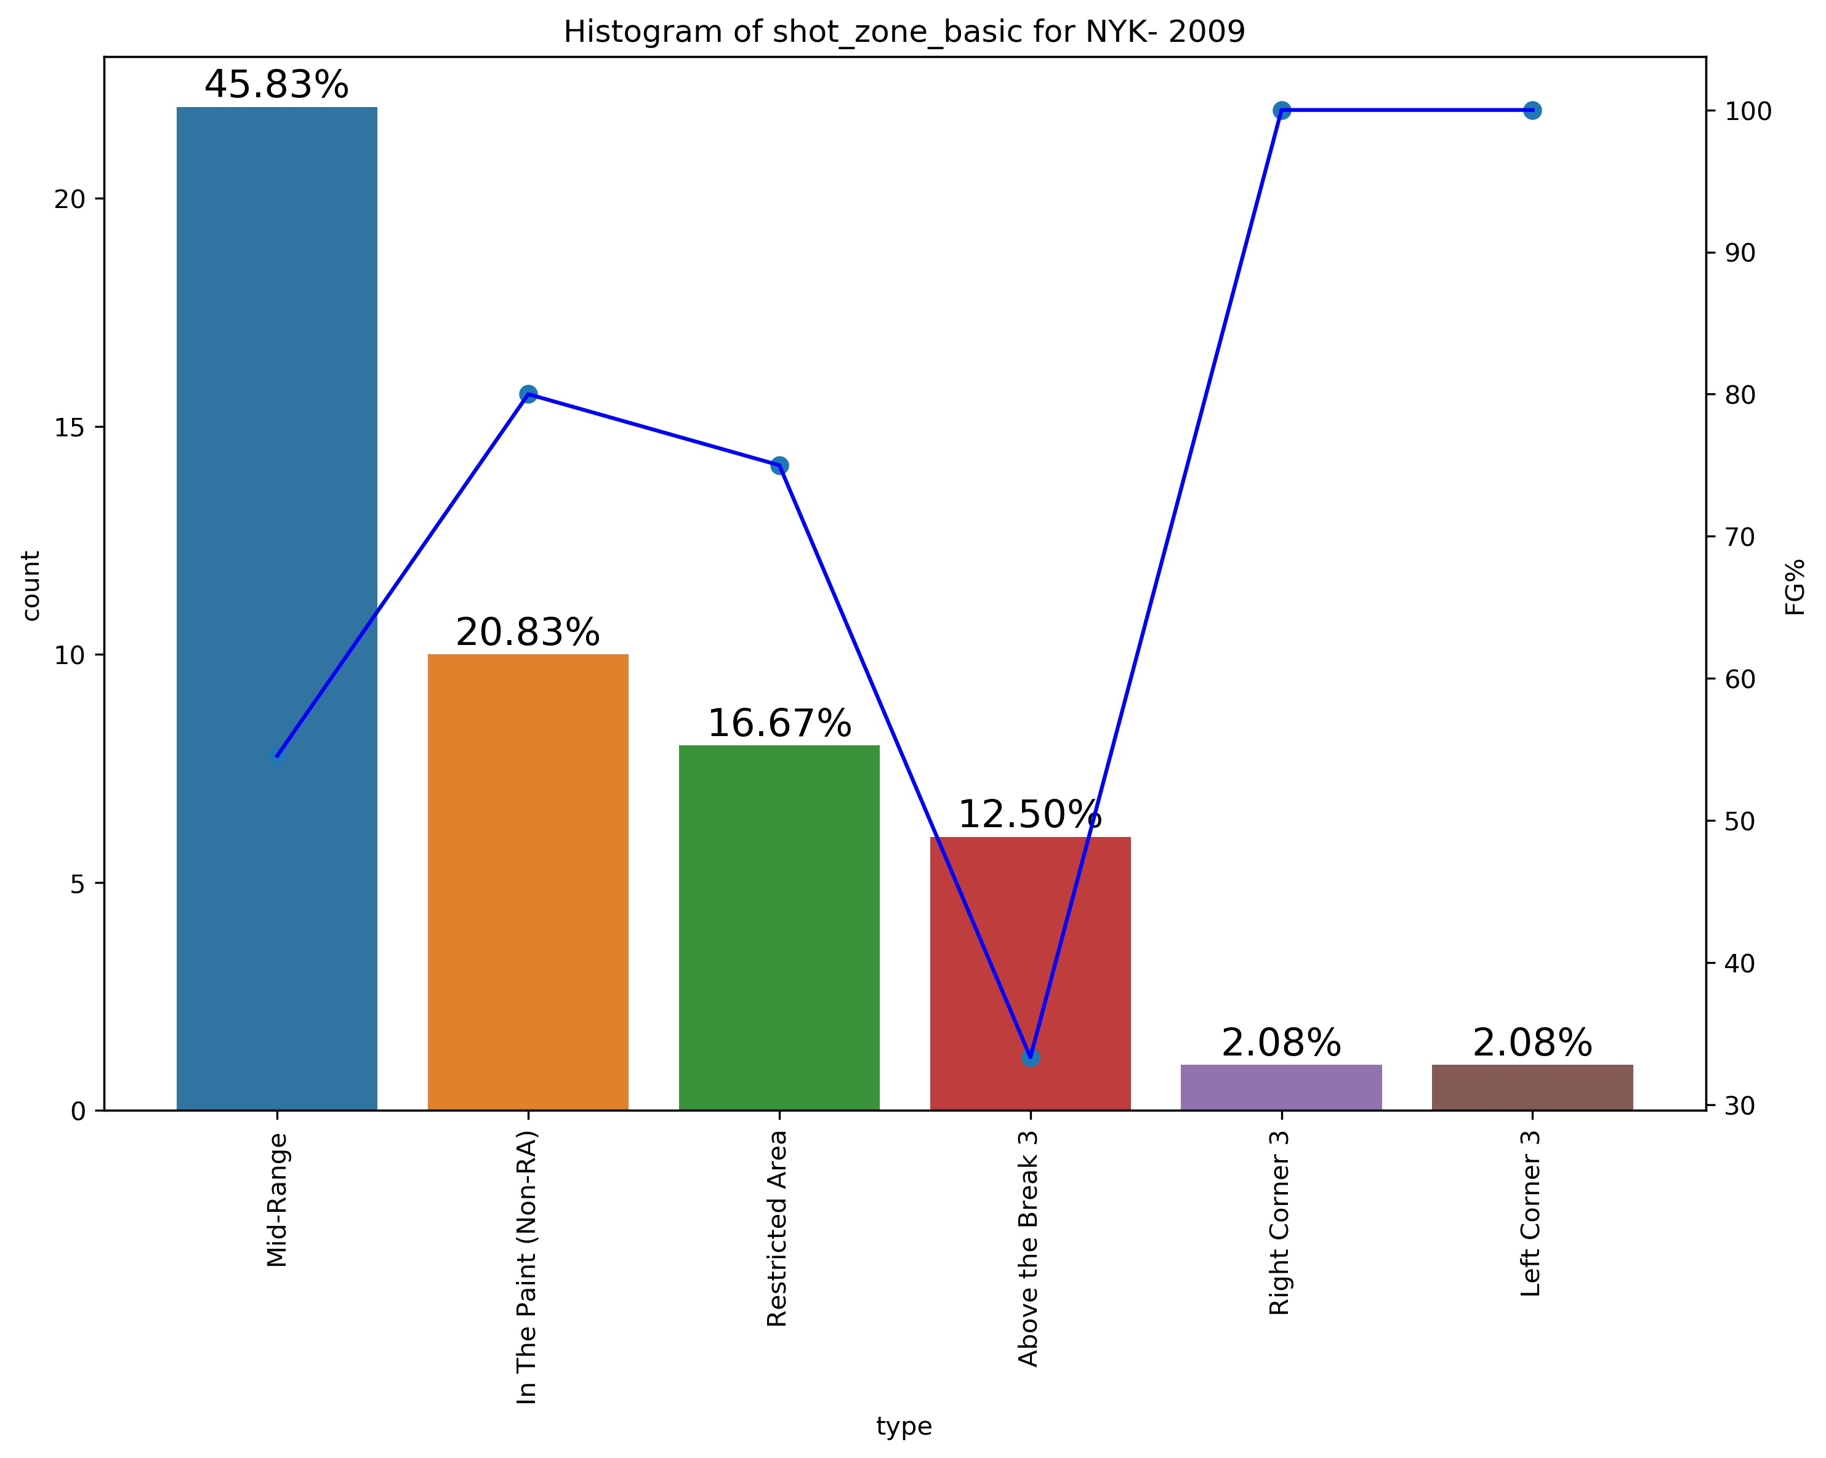
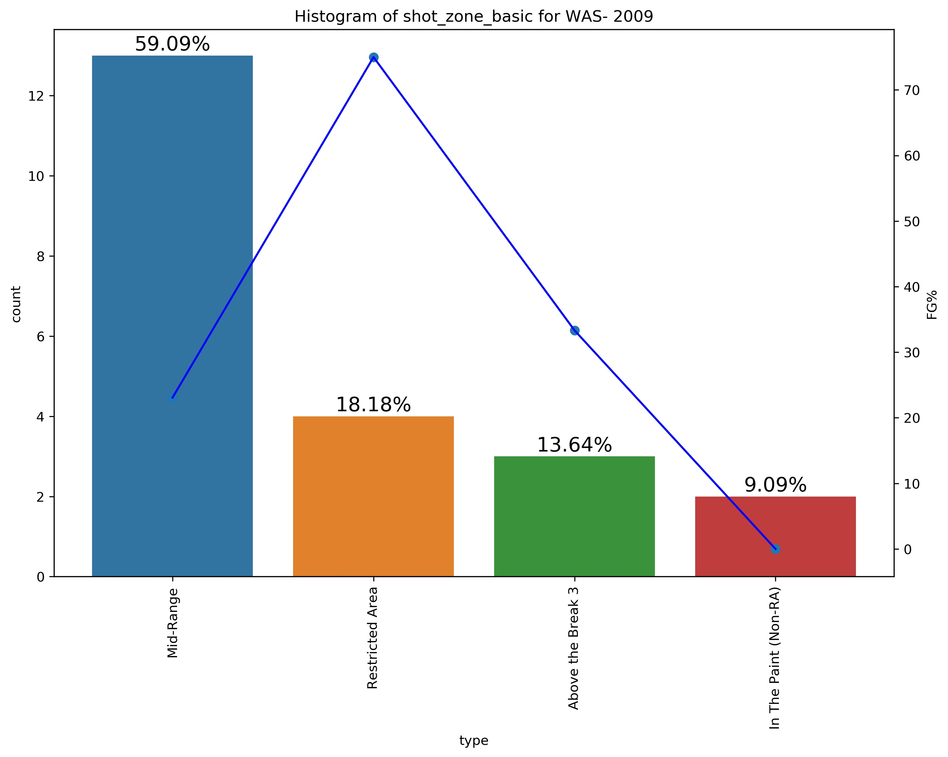
Opponent analysis - 2009
From both the graphs we can observe that kobe shoots mostly from Mid-Range area, followed by from Restricted Area also with highest FG% so the takeaway points is to force him away to shoot from longer regions.

Slide 24
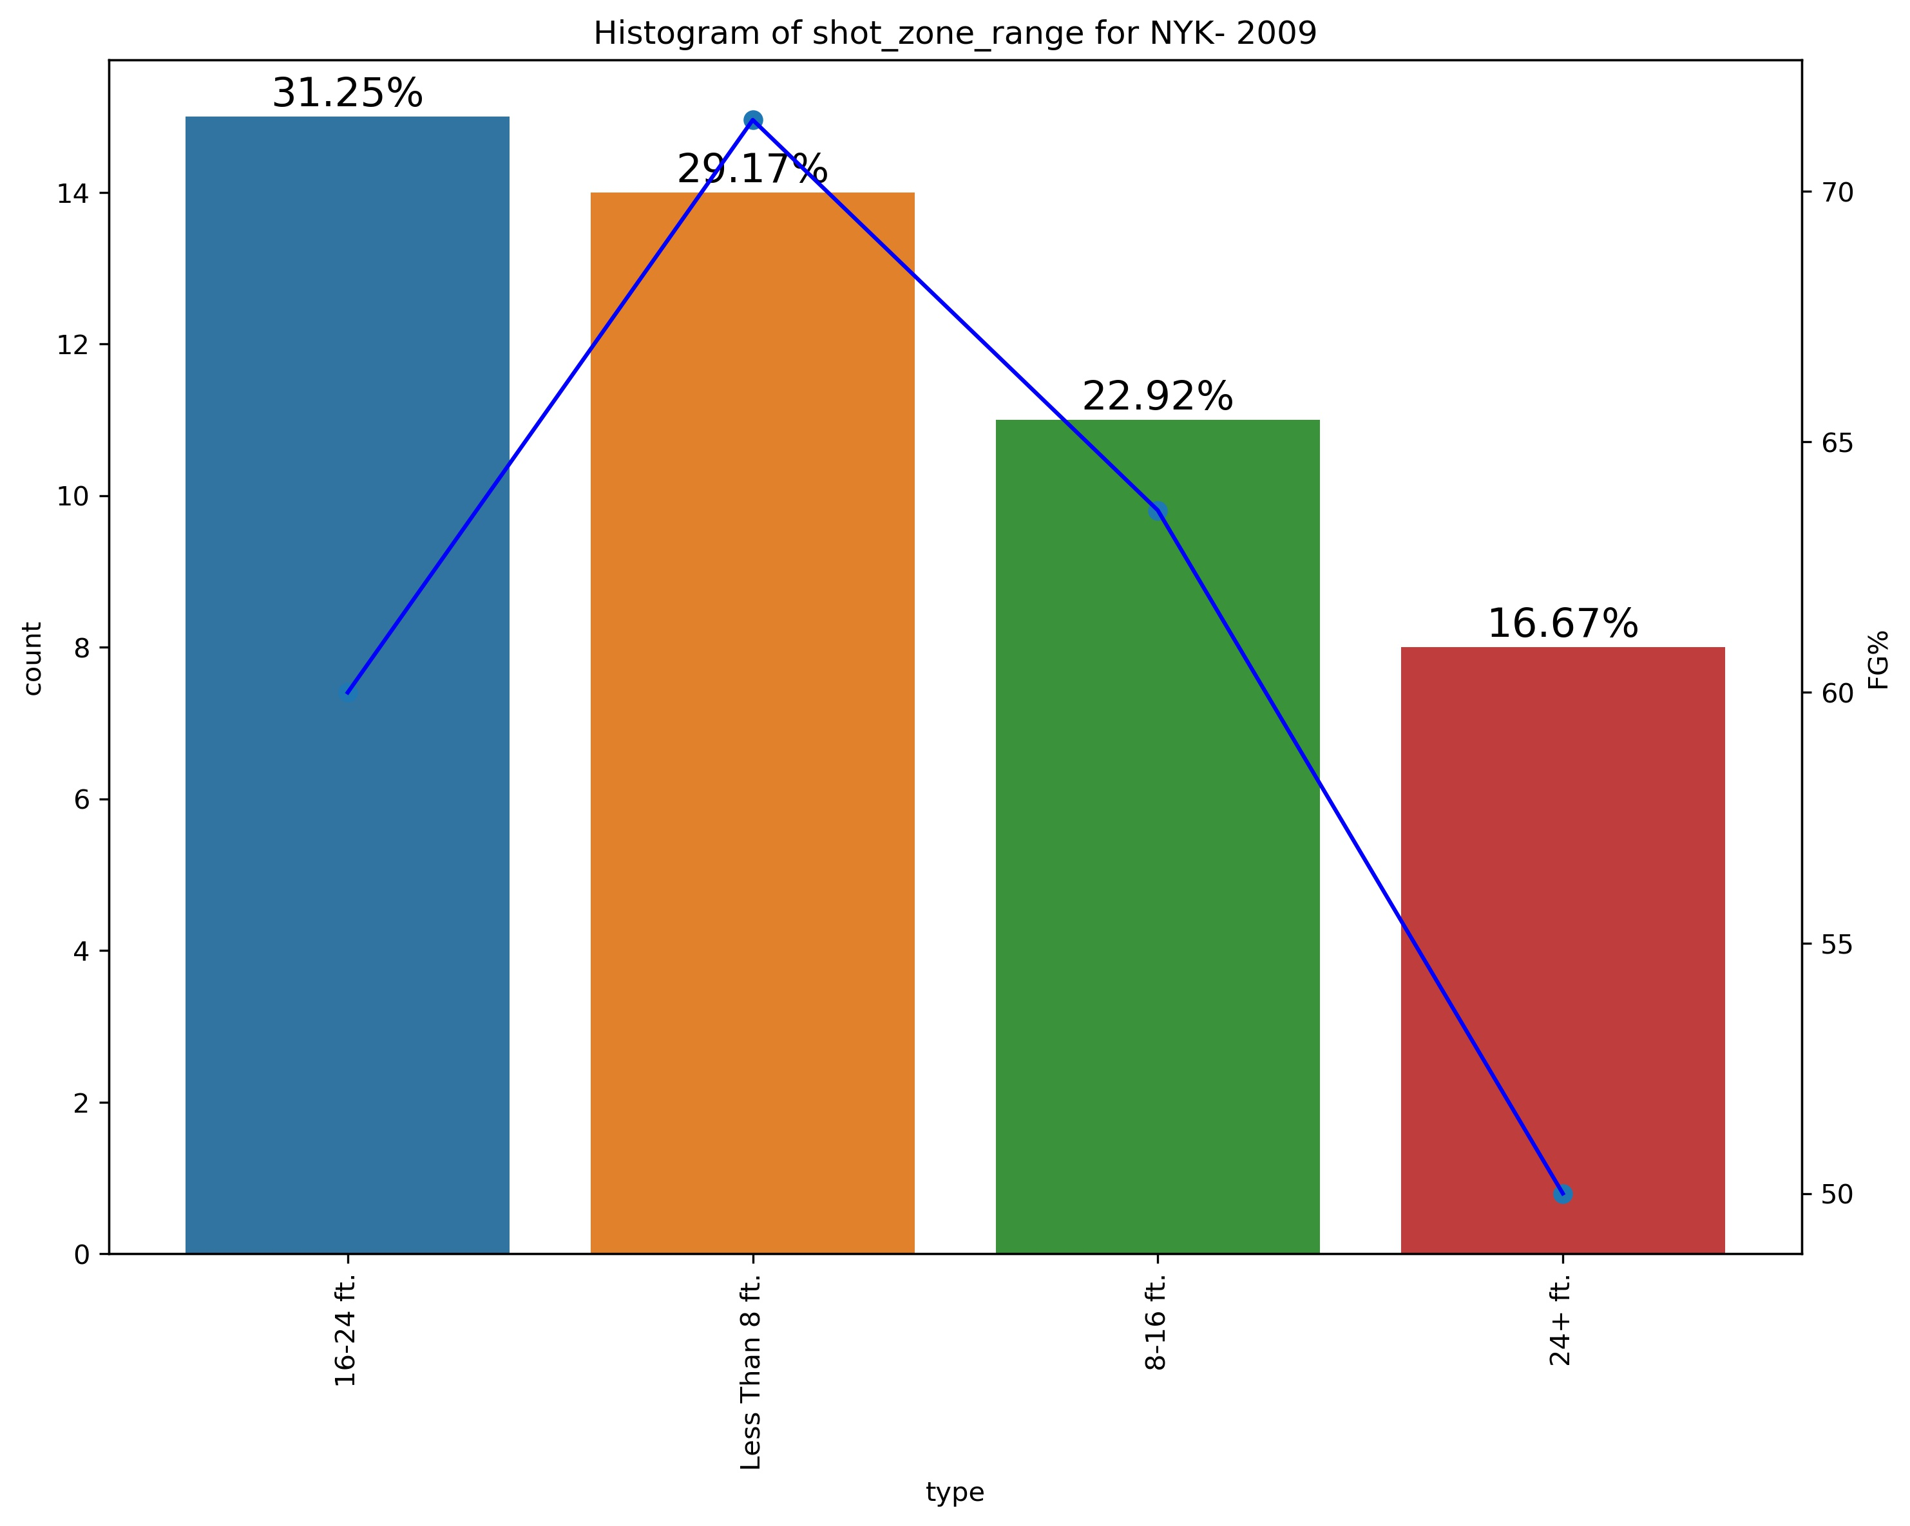
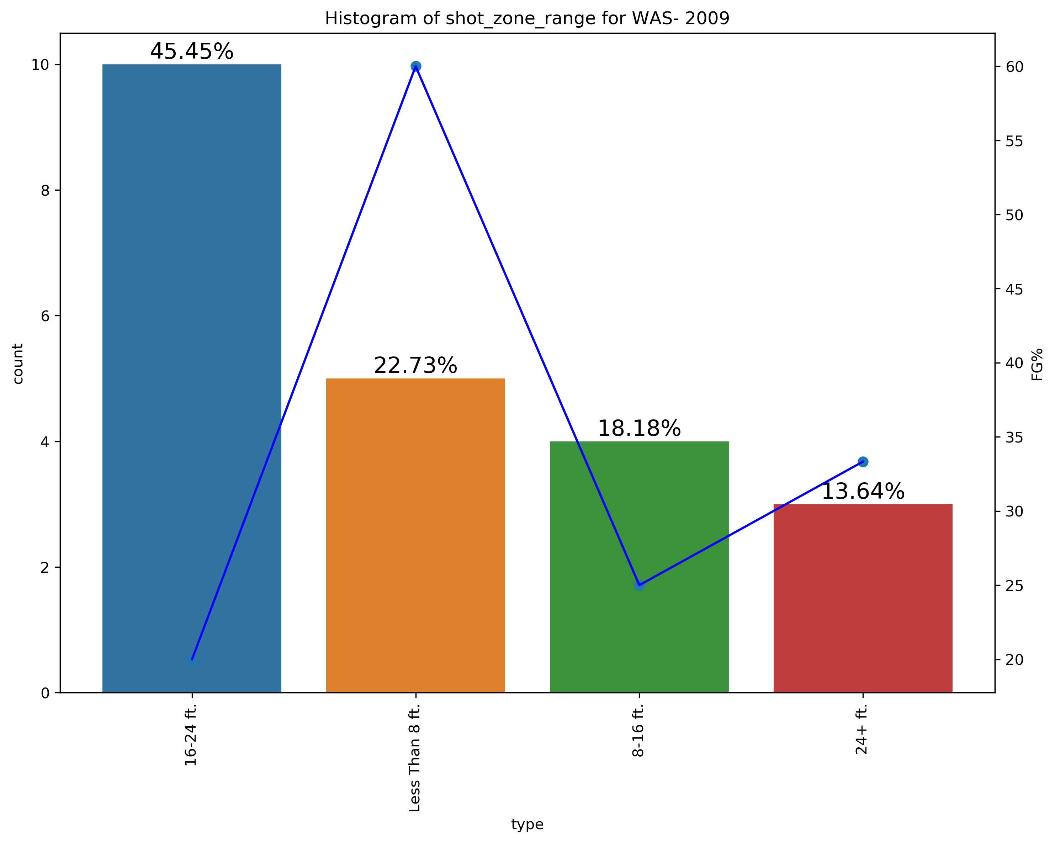
Opponent analysis - 2009
From the both graphs, we can observe that kobe shot most shots from ’16-24’ against both teams but shots from Less that 8ft have highest FG%.
So the takeway point is to guard him so that he does not reach Less than 8ft area from where he is most effective.

Slide 25
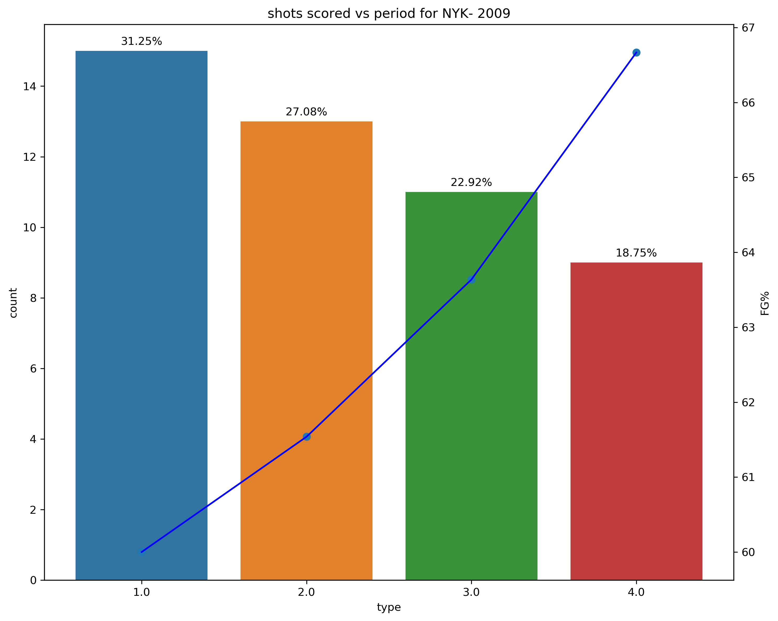
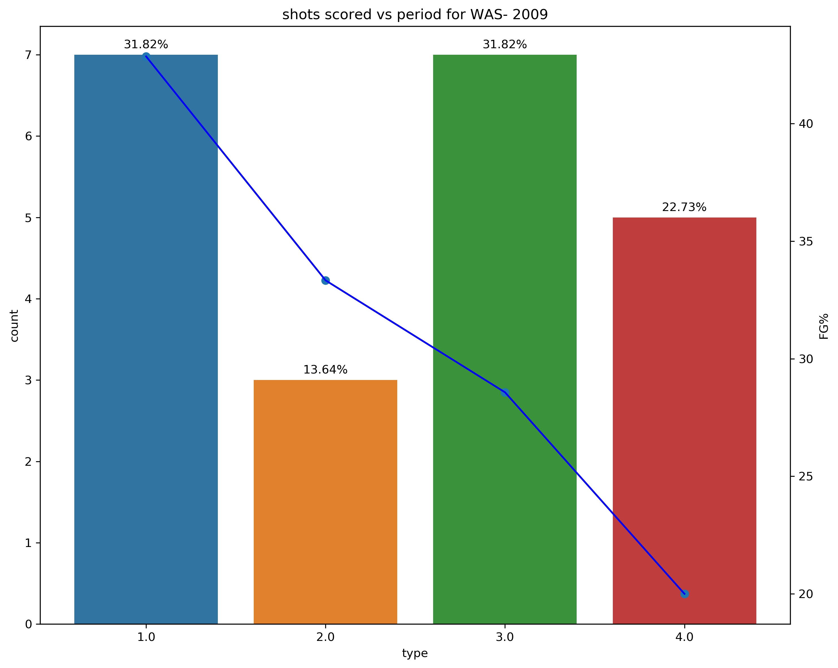
Opponent analysis - 2009
Against NYK we can observe that no. of shots kobe took decreased per quarter but his FG% increased as period changed.
Against WAS we can observe that they have restricted him in 2nd and 4th quarter with much less FG% in all quarters, so the takeaway point is to put more pressure in 2nd quarter and make him score with less accuracy so he might perform less in following quarters where he has less energy and also additional pressure to perform more to compensate form 2nd quarter.

Slide 26
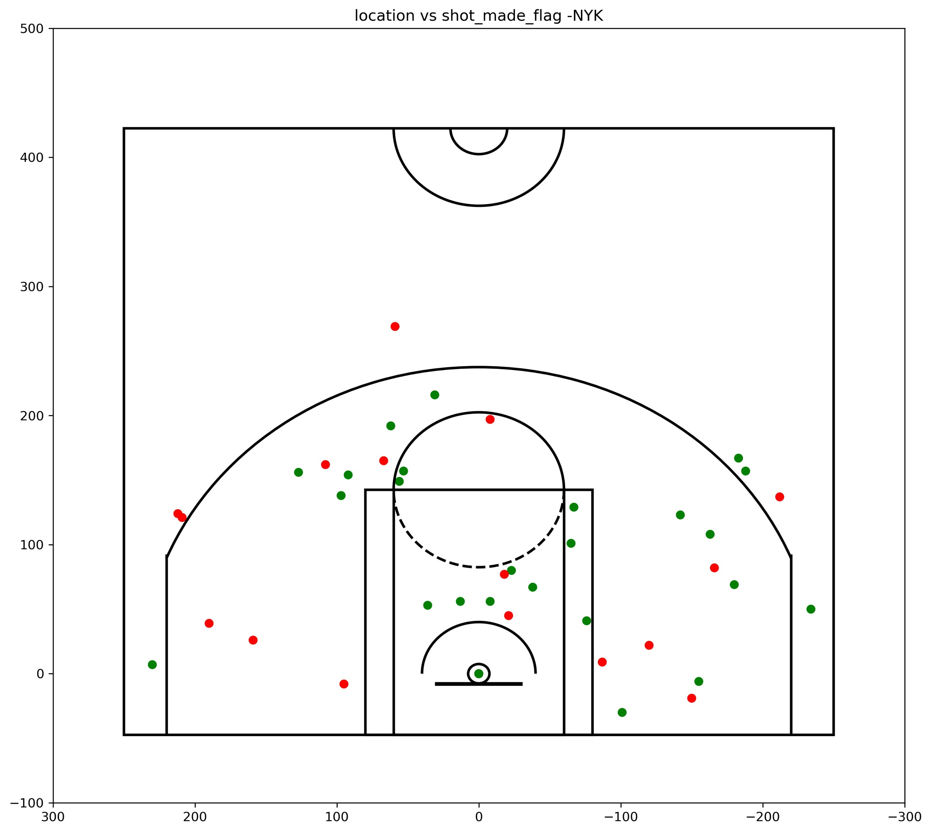
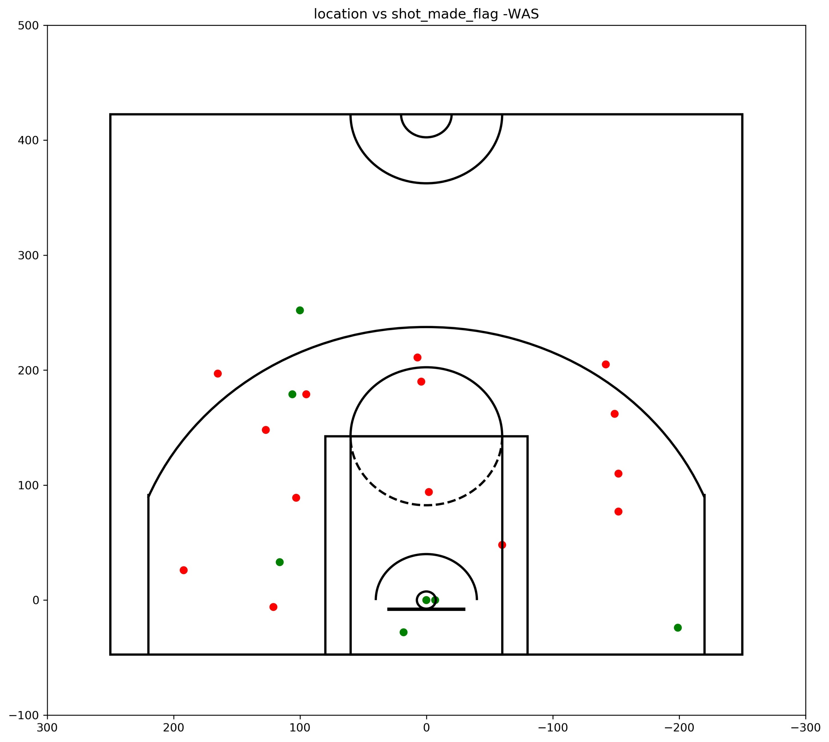
Opponent analysis - 2009

Slide 27
Model Building – Random Forest classifier
The Random forest classifier creates a set of decision trees from a randomly selected subset of the training set. It is basically a set of decision trees (DT) from a randomly selected subset of the training set and then it collects the votes from different decision trees to decide the final prediction.
We can change the no-of estimators and get results in the form of classification report and confusion matrix. We can perform feature reduction by comparing the importance of the features to get more efficient models.
The random forest classifier algorithm is being built using the Scikit Learn Package.

Slide 28
Model building – Multilayer Perceptron (MLP) classifier
(need to fill the model definition)
We can change parameters like activation, hidden layers, solver, momentum, early stopper to optimize the model according to the dataset to obtain preferable results in form of classification reports and confusion matrix.
The multilayer perceptron classifier algorithm is being built using the Scikit Learn Package

Slide 29
Performance measure
Confusion matrix
Classification report
Accuracy
Mean squared error
ROC_AUC

Slide 30
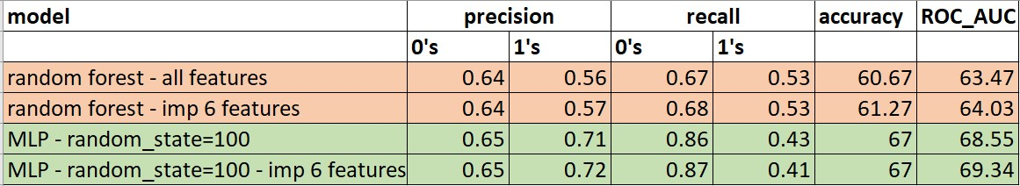
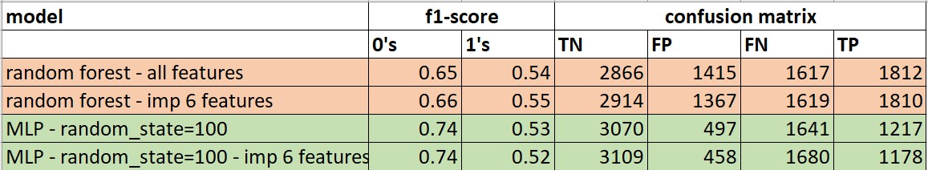
Results – random forest vs MLP

Slide 31
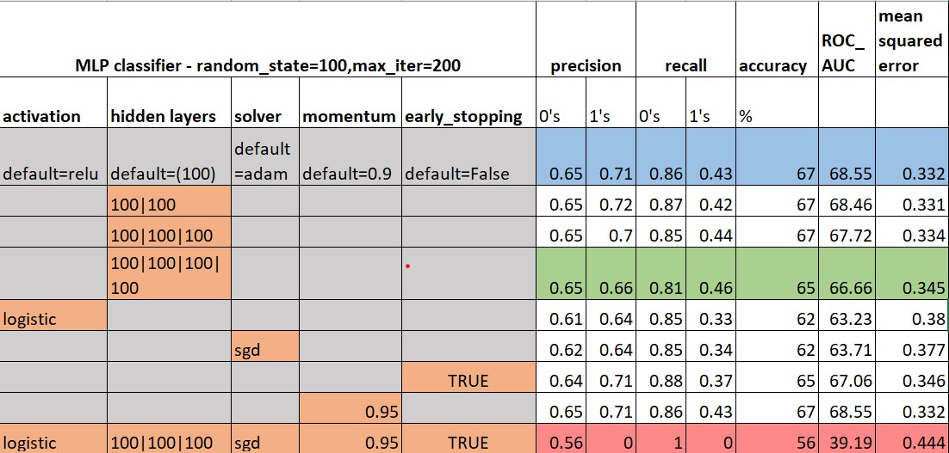
Results – parameter changes in MLP

Slide 32
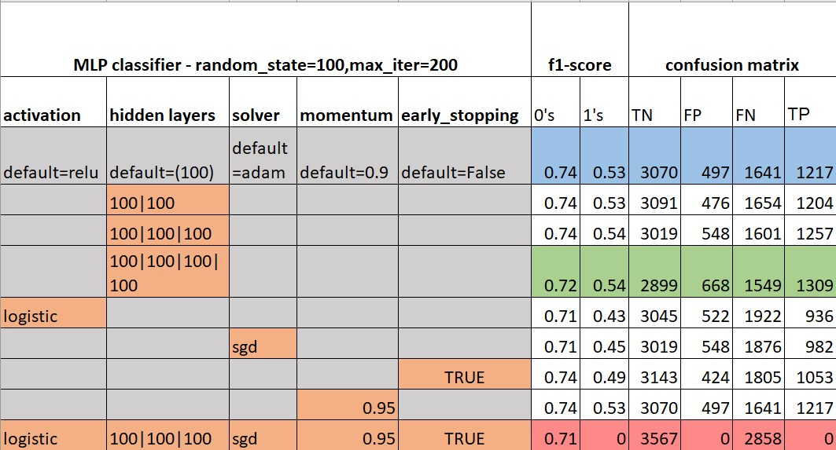
Results – parameter changes in MLP

Slide 33
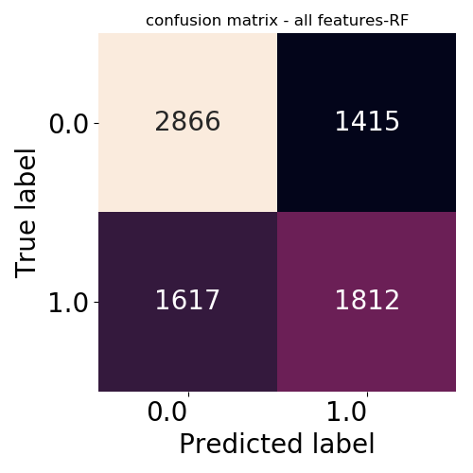
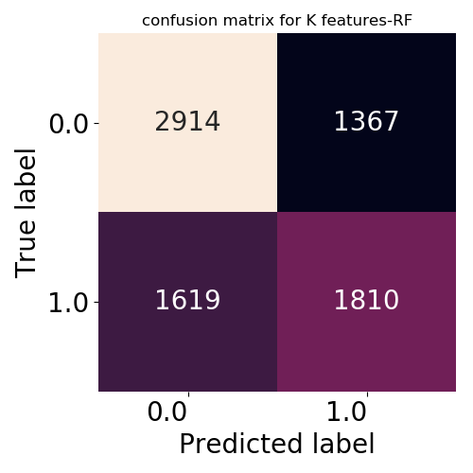

Slide 34
